Slide 1
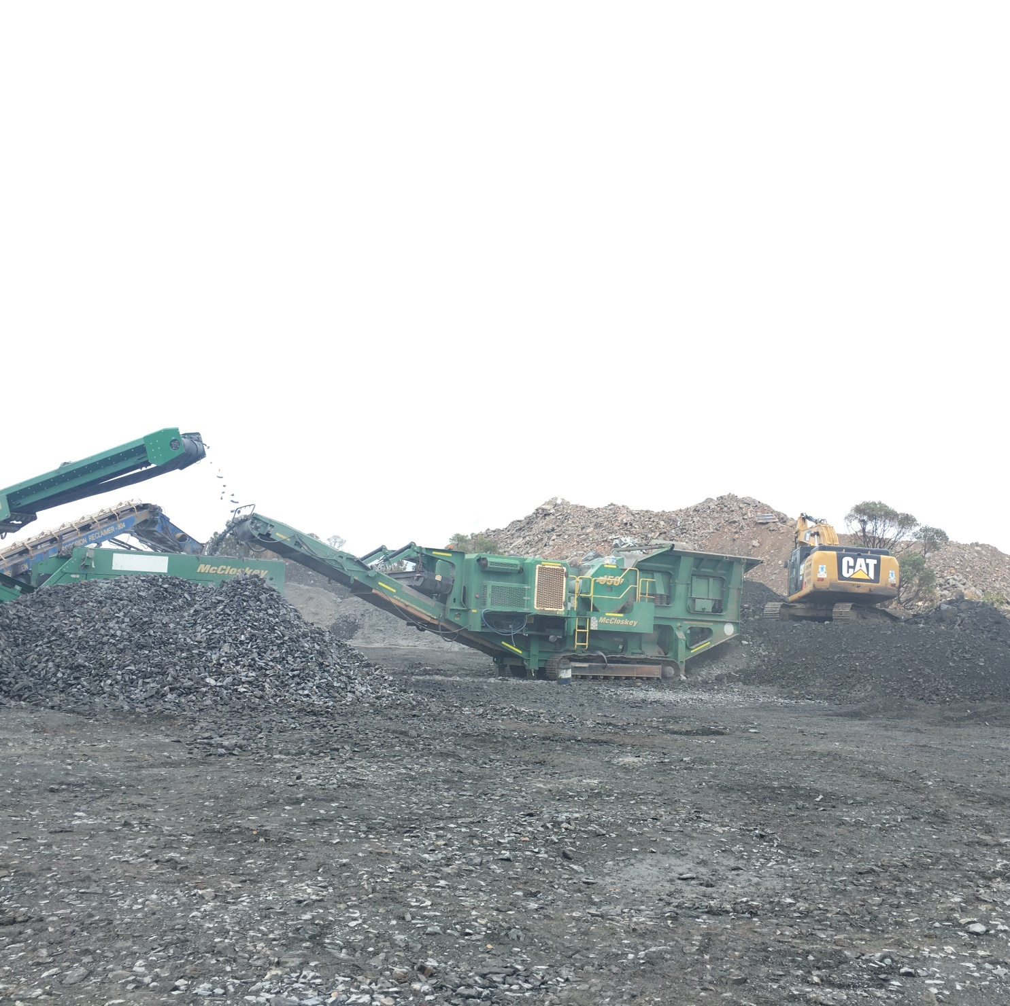
1.75 Creation and Stimulation of End Markets for Construction and Demolition Waste
Presenters:
Professor Tim Ryley
Dr Savindi Caldera

Slide 2
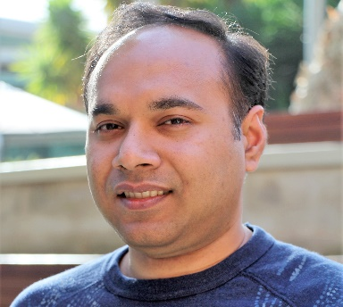
Research team & expertise
Professor Tayyab Maqsood RMIT University
Associate Dean in PM
Supply chain optimisation
Professor Peter SP Wong
RMIT University
Associate Dean in CM
Design for Manufacture & Assembly
Dr Salman Shooshtarian Lecturer RMIT University
Circular economy
Dr Atiq Zaman
Senior Lecturer
Curtin University
Sustainable waste management
Professor Tim Ryley
Griffith University
Head of Aviation
Behavioural change
A/Prof Rebecca Yang
RMIT University
Leader of Solar Energy Lab
Construction innovation
Dr Savindi Caldera
Griffith University
Research Fellow
Green construction & manufacturing

Slide 3
C&D Waste Project Research Pathway (2018-2023)
Project 1.65
Review jurisdictional waste regulations
Consistent approach to define and measure C&D waste
Economic factors governing C&D waste recovery
Develop an integrated supply chain lifecycle model
Project 1.75
Review waste regulations governing market development
Analyse the existing markets operation
Application of sustainable procurement in Australia
Develop a framework for waste market creation and stimulation
Project 1.85
Identify factors influencing the use of recycled products
Develop framework for recycled product certification program Application of sustainable procurement in Australia
Develop stakeholder guided behavioural change strategies
Completed (2018-2020)
Completed (2020-2021)
In progress (2021-2023)

Slide 4
Project 1.75 Aims
Develop a national understanding of the operation and capacity of existing end markets for C&D waste in Australian jurisdictions.
Conduct a gap analysis was conducted to establish the need for new potential end markets and strategies to create these new markets will be provided.
Suggest strategies for improved management of C&D waste, which will create new opportunities, contributing to new business development, business growth, higher employment and stronger economic conditions.

Slide 5
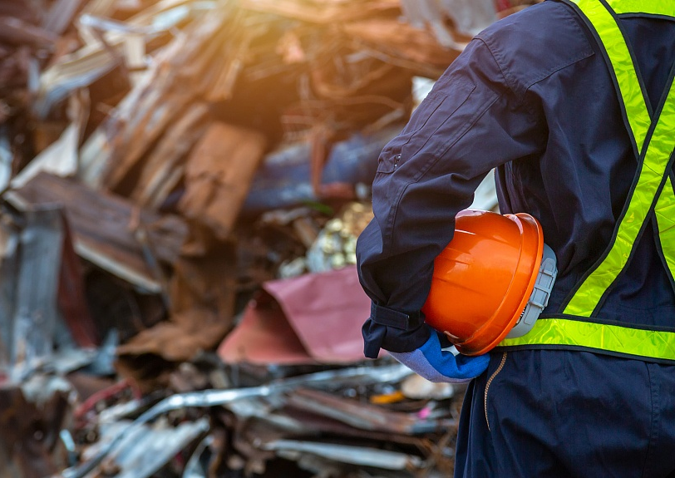
Project 1.75 Industry outcome
Provided a review of C&D waste management regulations that impact end markets for C&D waste in Australia;
Identified relevant specifications/guidelines/standards affecting the use of recycle materials and make appropriate recommendations;
Developed an understanding of economic drivers/barriers contributing to the successful operation of end markets and their stimulation;
Provided an understanding of sustainable procurement guidelines impacting on the operation of C&D waste end markets;
Developed a model and associated guideline to create and stimulate end markets for C&D waste in Australia.

Slide 6
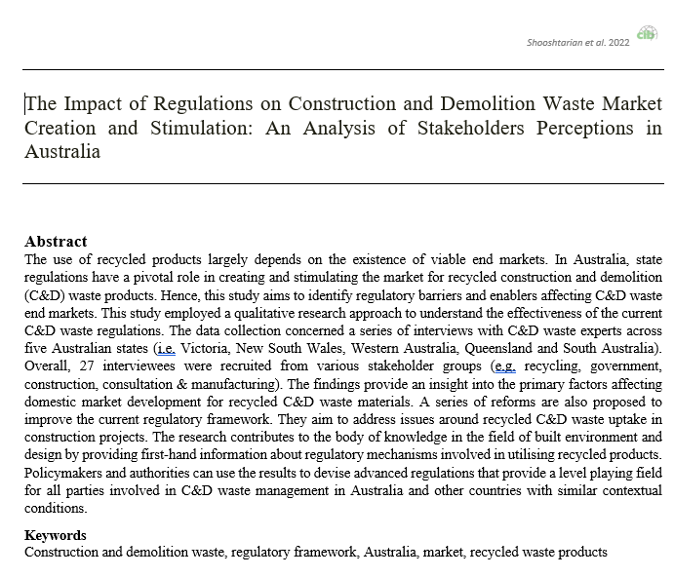
Objective 1. Review and identify state waste regulations affecting the development and operation of end-markets for C&D waste stream
The review demonstrates differences and similarities in the Australian states and territories regulatory frameworks concerning the development and stimulation of end markets for C&D waste recyclables.
This study analysed 102 federal, state and territories government policies, standards, guidelines, legislation and specifications to determine the extent to which the Australian regulatory frameworks are in favour or against C&D waste market development

Slide 7
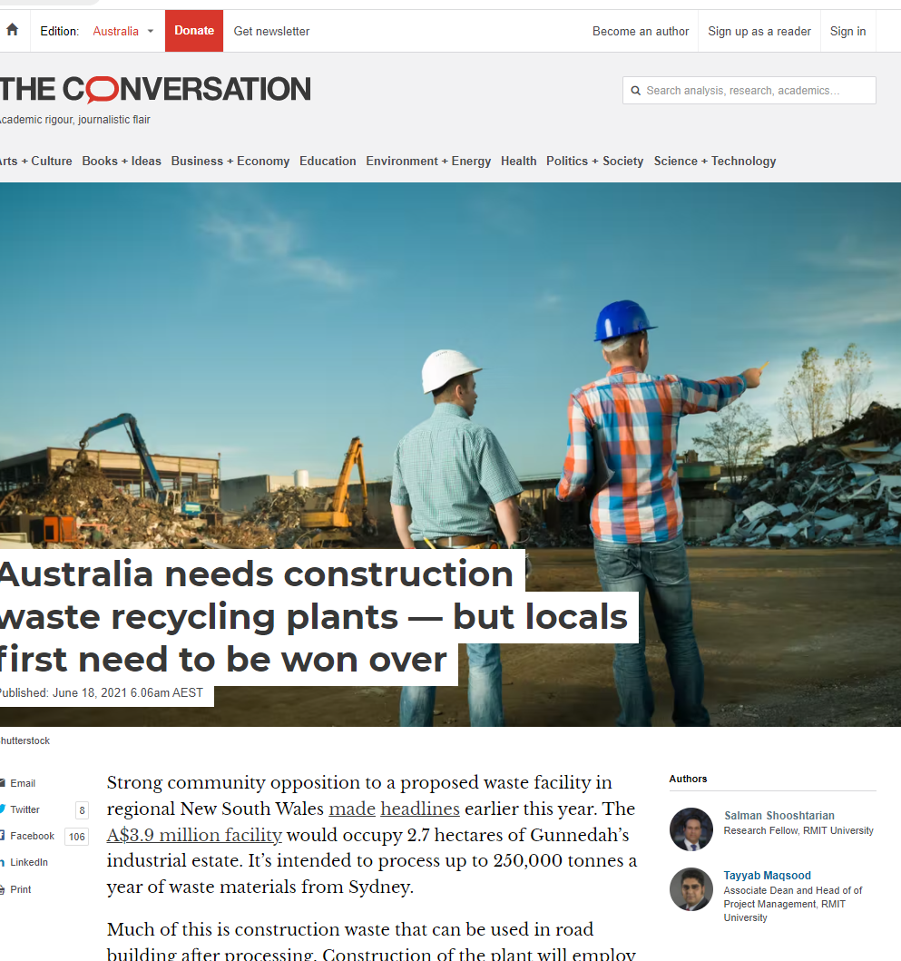
Objective 2. Analyse the operation of existing markets in Australian jurisdictions identifying related economic and technical barriers
This review demonstrates differences and similarities in the existing end markets operation for C&D waste resources across Australian states and territories.
For each state and territory, several recommendations are provided that can assist policymakers, researchers, and practitioners to contribute to the creation and stimulation of end markets.
This report identified major barriers to the operation of existing C&D waste end markets based on literature review
To overcome these barriers, several strategies are put forward

Slide 8
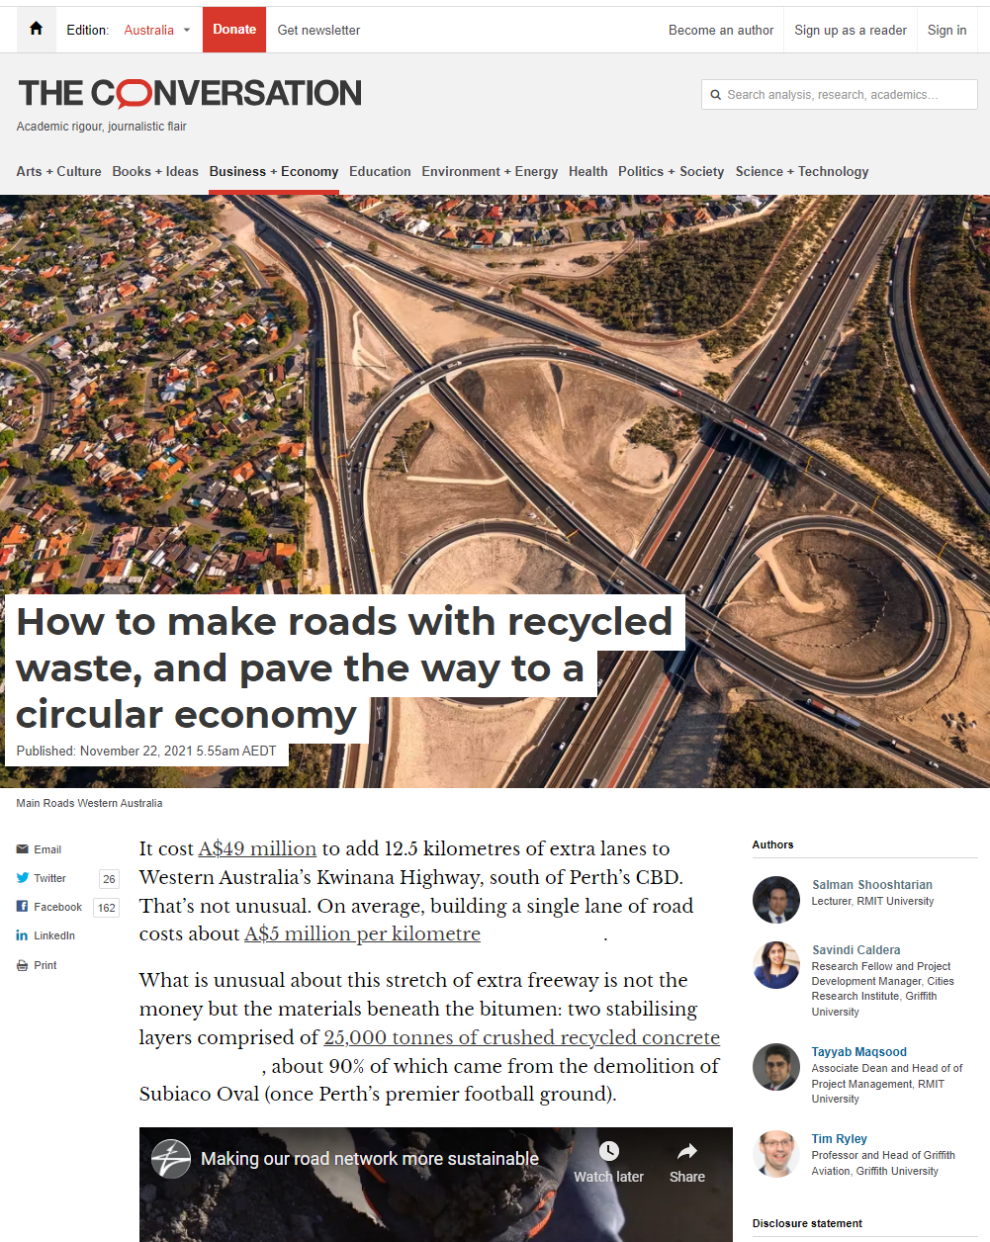
Objective 3. Review how sustainable procurement guidelines in Australia may enhance operation and size of C&D waste end markets
It is argued that purchasing power of the government can create demand for recycled C&D products.
This report reviewed sustainable procurement policies and practices in Australia and overseas.
To further understand the effectiveness of sustainable procurement initiatives, the major enablers and drivers of the adoption of SP were identified.
This is completed with demonstration of sustainable procurement models that can be applied to C&D waste stream.

Slide 9
Objective 4. Develop and validate a model for development of markets for C&D waste in Australian states in the context of related regulations.
The creation and stimulation of end-markets for C&D waste require the involvement of various parties.
Drawing on interviews with 27 C&D waste experts in four states (WA, Vic, QLD, NSW and SA), this report provides an insight into the main challenges and opportunities in end-market development as identified by key stakeholders.
Where possible recommendations for reforms based on comparative analysis of state-based information are provided.
While we made every effort to recruit participants representing various stakeholder groups, it is noteworthy that the results presented in this report are indicative and not inclusive.

Slide 10
Research approach
A purposive sampling strategy was employed to recruit a wide range of participants across the C&D waste supply chain.
The main selection criteria was adequate experience in dealing with the management of waste in Australia.
Email communication was the method of recruitment.
The interviewees were conducted online, using the Microsoft Teams application
The interview consisted of several questions covering the main issues and opportunities regarding the development of the market for the recycled C&D waste materials.
A total of 27 interviewees were recruited from five states: (1) Western Australia (2) Victoria, (3) Queensland (4) New South Wales (5) South Australia
The composition of stakeholder groups among the interviewees
Notes:
And impacts of covid19

Slide 11
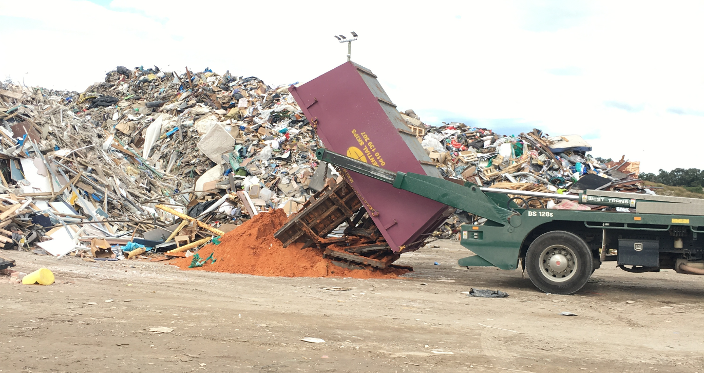
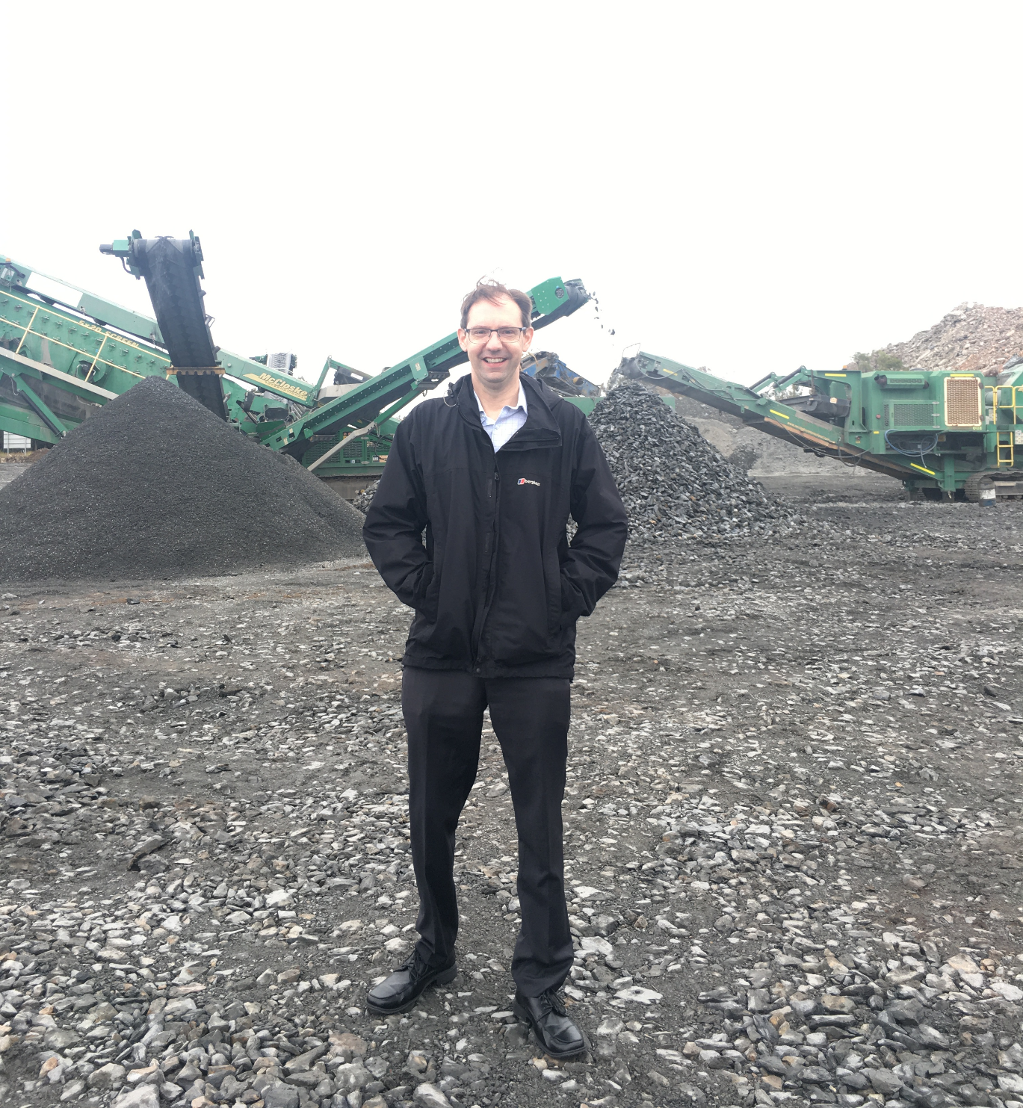
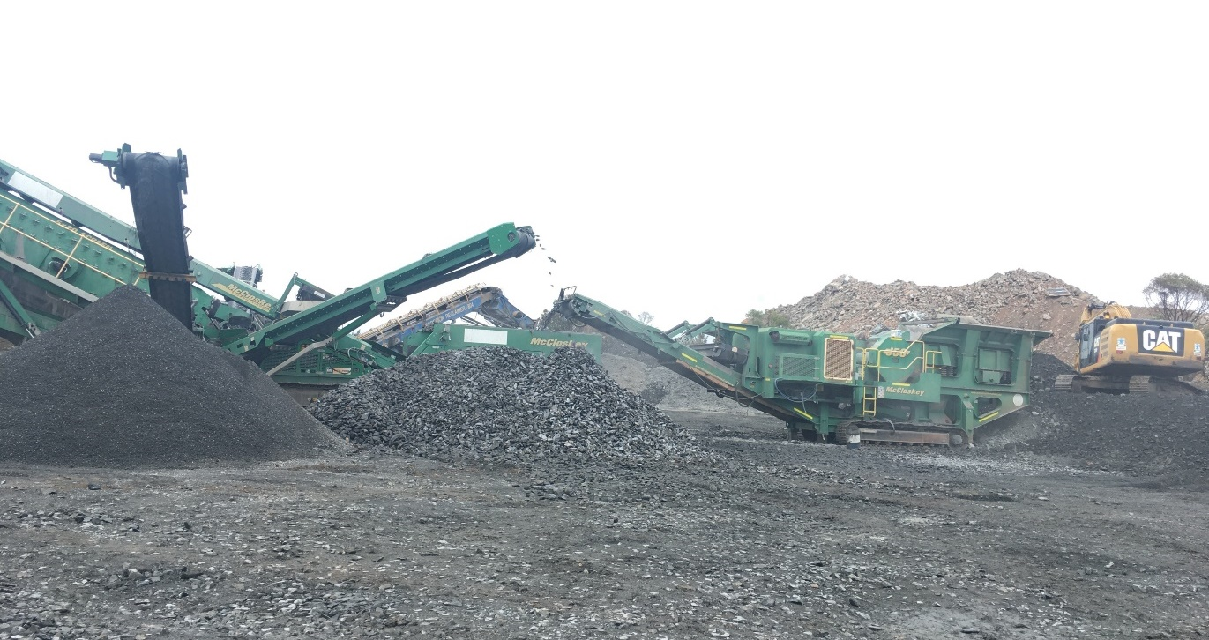
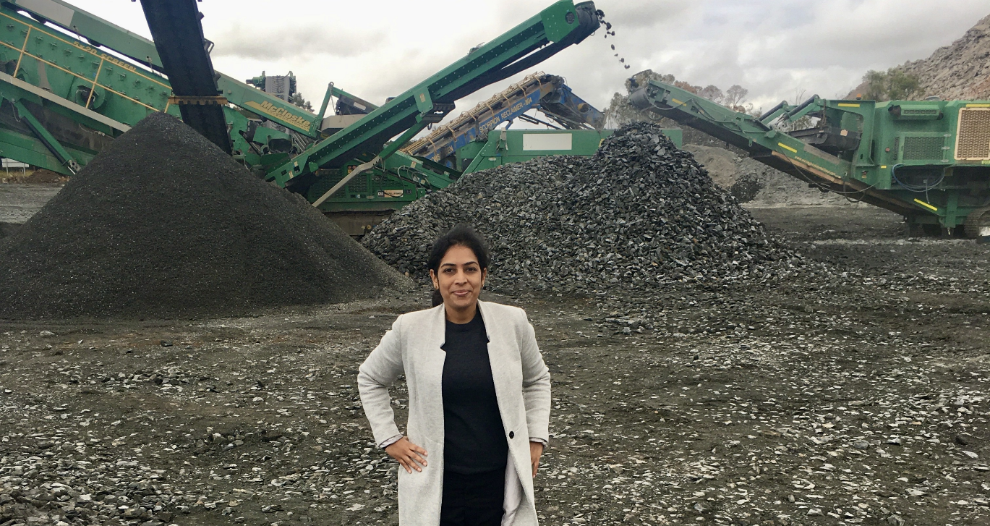
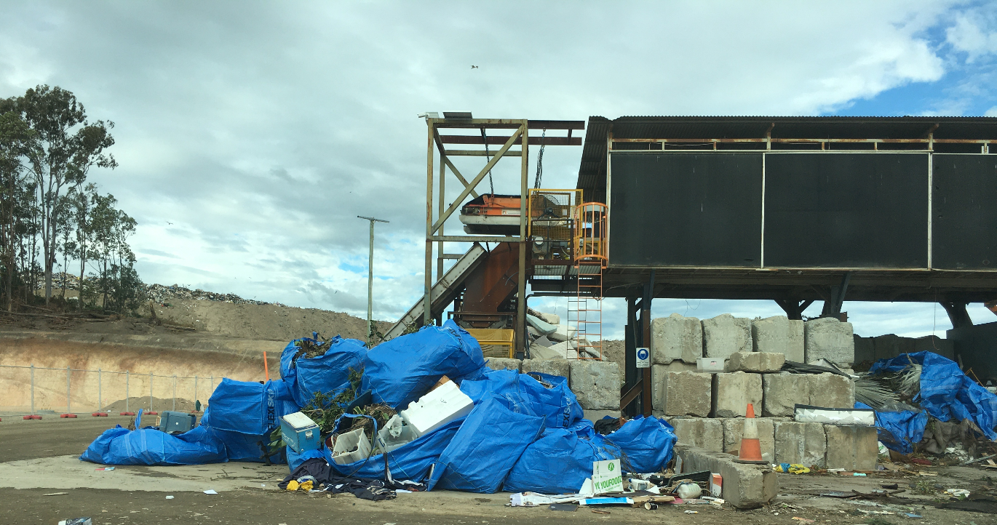
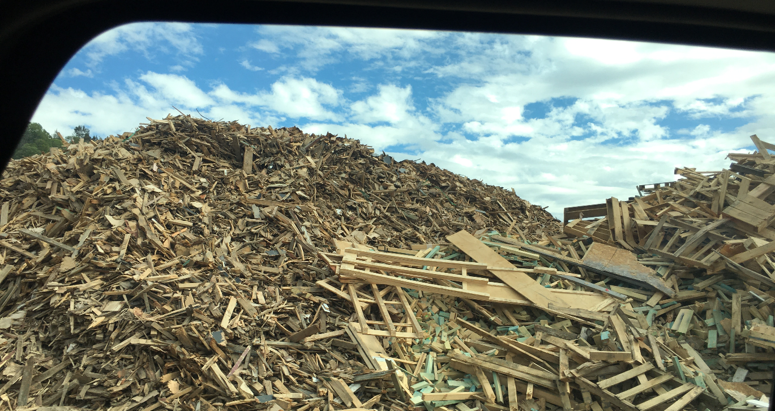
Site visit (Wholesale Sands and BMI resource recovery Centre in Woongoolba)

Slide 12
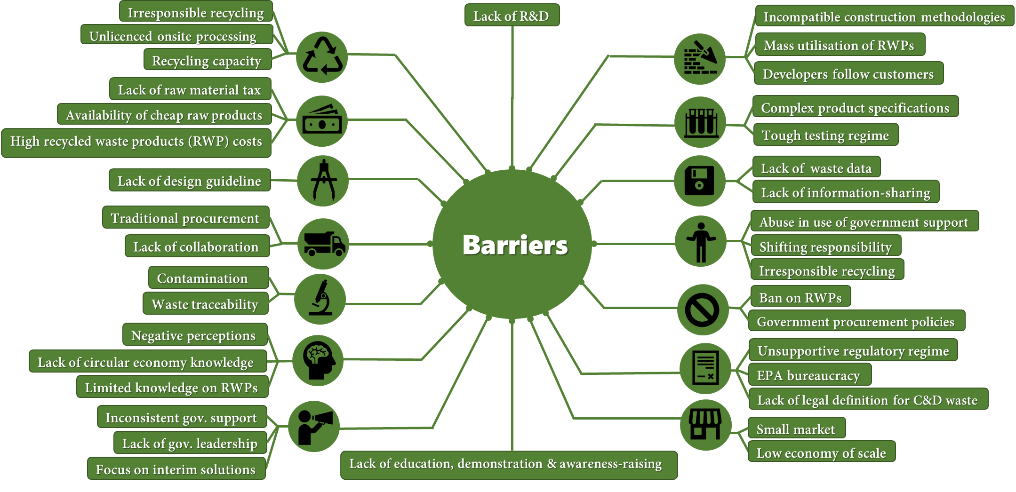
Barriers towards the creation and stimulation of markets for C&D recycled waste products
Notes:
Operations
Market
Governance
Logistics
the risk of contamination (i.e., asbestos), strict product specifications, lack of data traceability of material movement and irresponsible behaviour of rogue operators as key barriers.

Slide 13
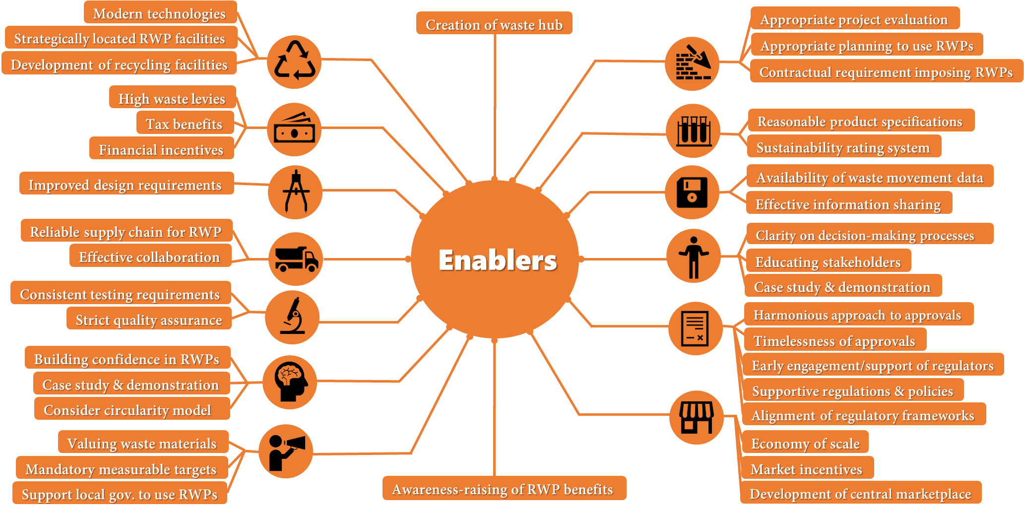
Enablers of the creation and stimulation of markets for C&D recycled waste products
Notes:
Encouragement
Education
Enforcement
Engagement
sustainable procurement, improving technologies for optimal levels of waste recycling development of infrastructure for cleaner waste streams and effective recovery, supporting local government and businesses to buy recycled products and a central waste marketplace.

Slide 14
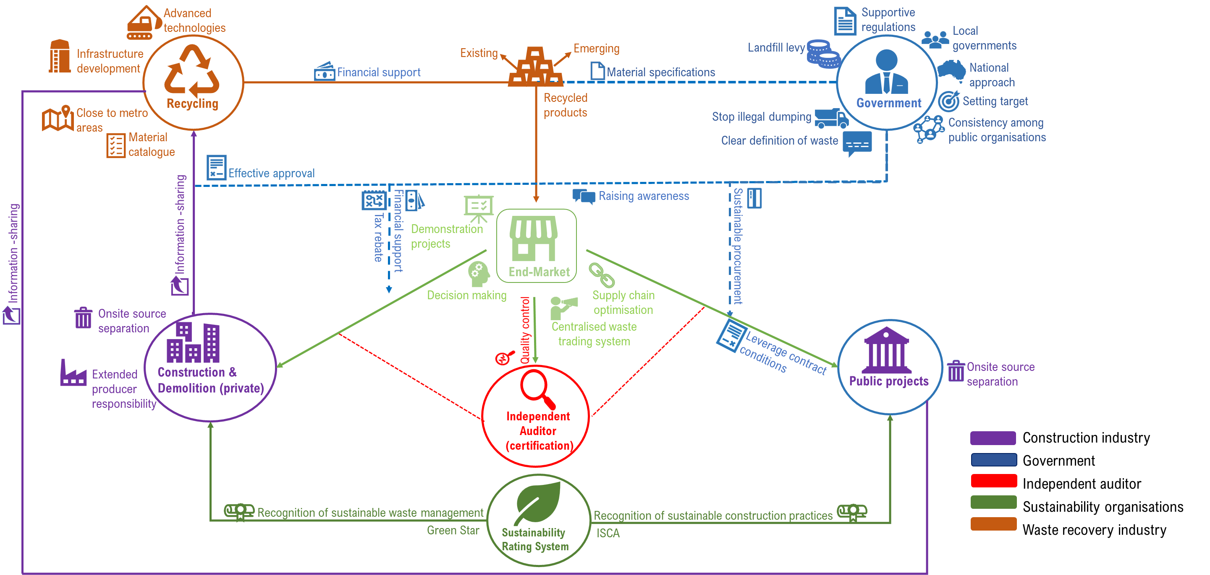
A framework for waste market development
Notes:
Maps how various enablers of market development can be implemented to optimise the interplay among multiple stakeholders in the C&D waste space.
the government sector should facilitate significant improvements through primary sustainable procurement strategies, raising awareness, adequate recycling approvals, provenance/traceability of the recycled components, simple and effective material specifications, leveraging contract conditions to use recycled products and financial support.
In the recycling sector, the four priority areas are to 1) invest in advanced processing technologies; 2) develop infrastructure with a suitable capacity to manufacture to the scale of the economy; 3) establish such facilities close to metro areas; and 4) generate material catalogues that detail recycled products information including their provenance and ingredients.

Slide 15
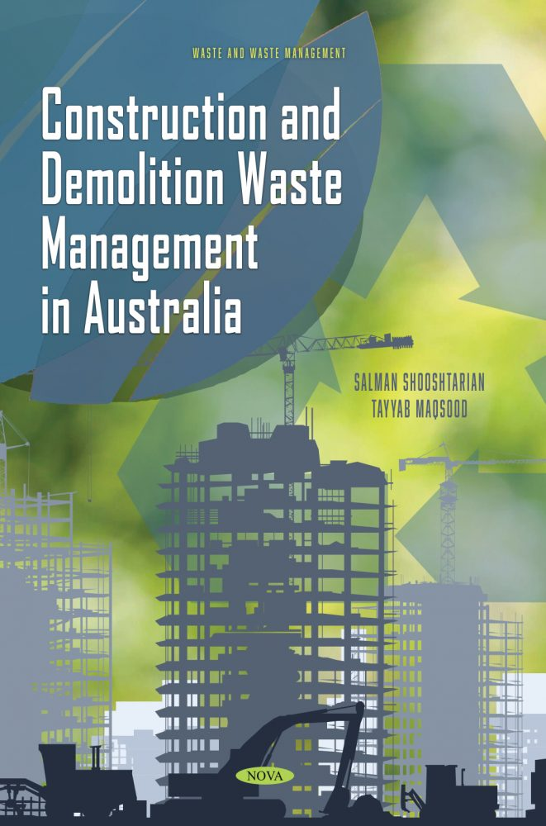
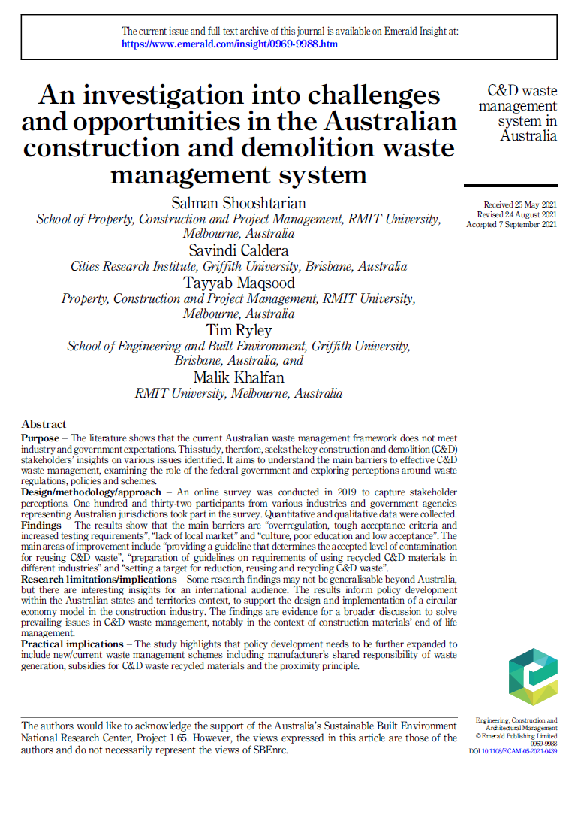
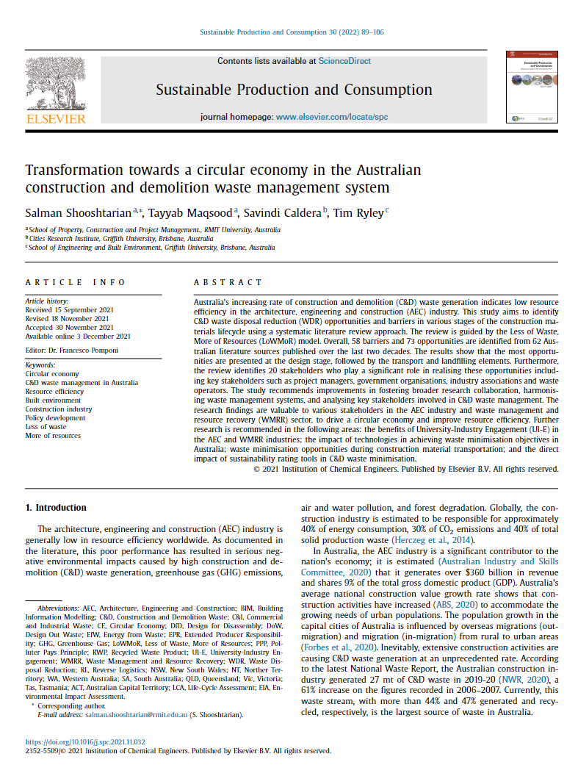
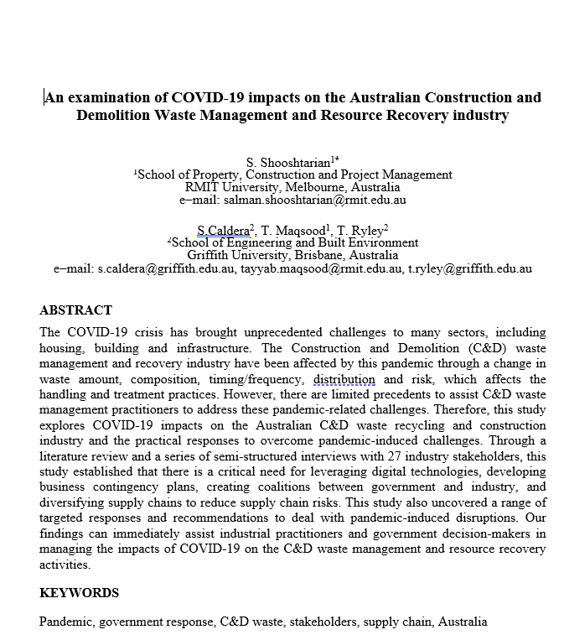
Research Impact-Academic
[Book]: Construction and demolition waste management in Australia (Nova Science Publishers) -2021
[Journal Articles]: 6 articles in ERA listed journals
[Industry/technical reports]: 6 reports
[Conference proceedings]: 3 papers (peer-reviewed)
[Online articles]: 3 articles

Slide 16
Project based book International Impact
Link:
https://bit.ly/36bY17X

Slide 17
Research Impact-Industry
[Online Portal]: National Construction & Demolition Waste Research and Industry Portal
The Conversation: 38, 346 reads (40% overseas readers)
Invitation by Department of Agriculture, Water and Environment to provide input in their waste management workshops

Slide 18
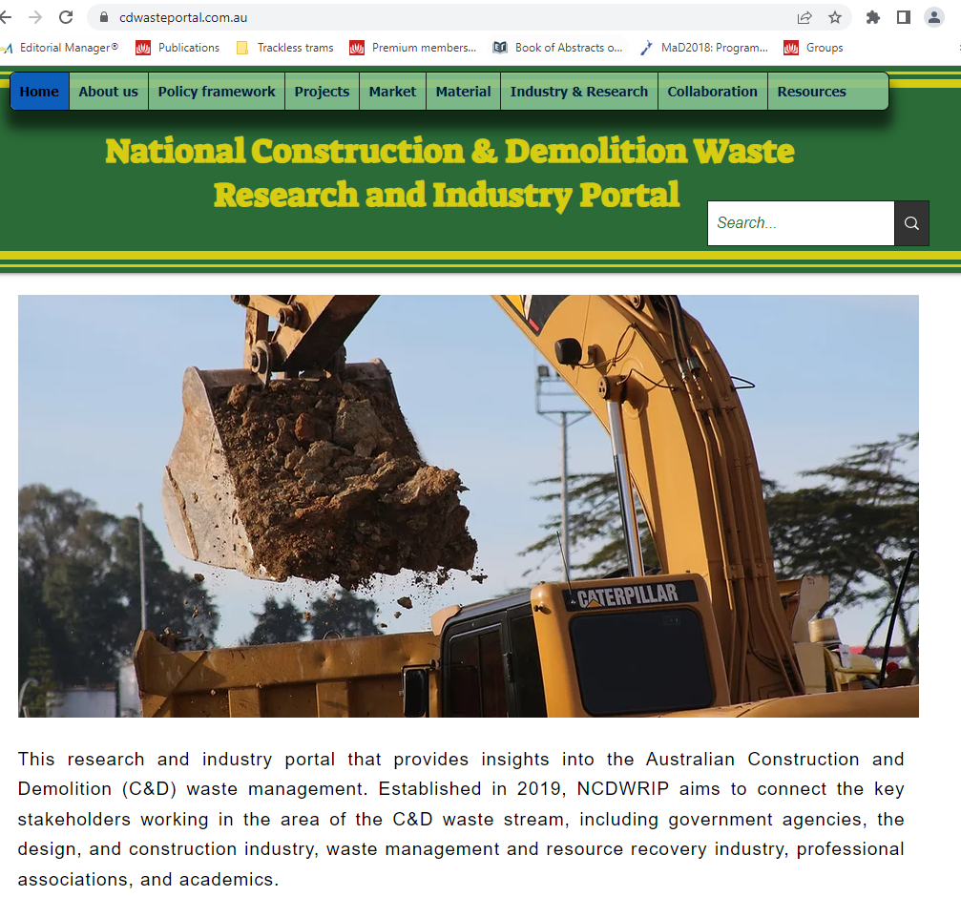
C&D Waste Portal
Link: www.cdwasteportal.com.au

Slide 19
Connection with CIB
Project Leader is the Joint Coordinator of W115 Construction Materials Stewardship
Some activities in progress are:
Renewing W115 aims and objectives
Recruiting more members
Developing collaborative research agenda

Slide 20
Conclusions
This SBEnrc project provided a detailed synopsis of end-markets’ operation and set-up for C&D waste recyclables in Australia.
This project may drive circularity of waste recyclables in the housing, building and infrastructure sectors in Australia and improve the demand for C&D waste recyclables.
The outcomes of this research may assist policymakers to identify the opportunities and challenges in sustainable waste management; encourage the industry to reduce its impact on the environment; motivate waste recovery facilities to find demand for their products; and help the public to benefit from a sustainable society.

Slide 21
Moving forwards
In this project, we focused on developing an understanding of trading C&D waste recyclables in Australia.
The next challenge is to bridge the missing link for enhancing the sustainable use of recyclables in construction projects.
Chief among others are identifying factors affecting the use of products with recycled content; developing a certification program assuring their quality and performance; creating design guidelines to increase their uptake; and exploring education-based strategies to change behaviour among stakeholders towards their increased application in construction projects.
Such efforts are needed to ensure increased business opportunities and benefits for manufacturers of such products and to achieve circular supply chain sustainability.

