Slide 1

SBEnrc Project 2.82
Digitally-enabled Asset Life-cycle Management
Prof Peng Wu, Curtin University
Dr Jun Wang, Western Sydney University

Slide 2
Project Aim and Objectives
This project seeks to examine the industry best practices and international standards related to
the value of DE and BIM and develop a practical approach that can efficiently guide industry
people to keep their DE models alive after construction and handover.
1. To demonstrate the value of BIM, especially for small-scale built projects.
2. A DE-enabled asset life-cycle management process and prototype
3. To demonstrate the use of latest technologies, e.g. image processing, for collecting real-time asset
condition and investigate the approach to translate the raw data collected from these latest technologies
into useful asset data.

Slide 3
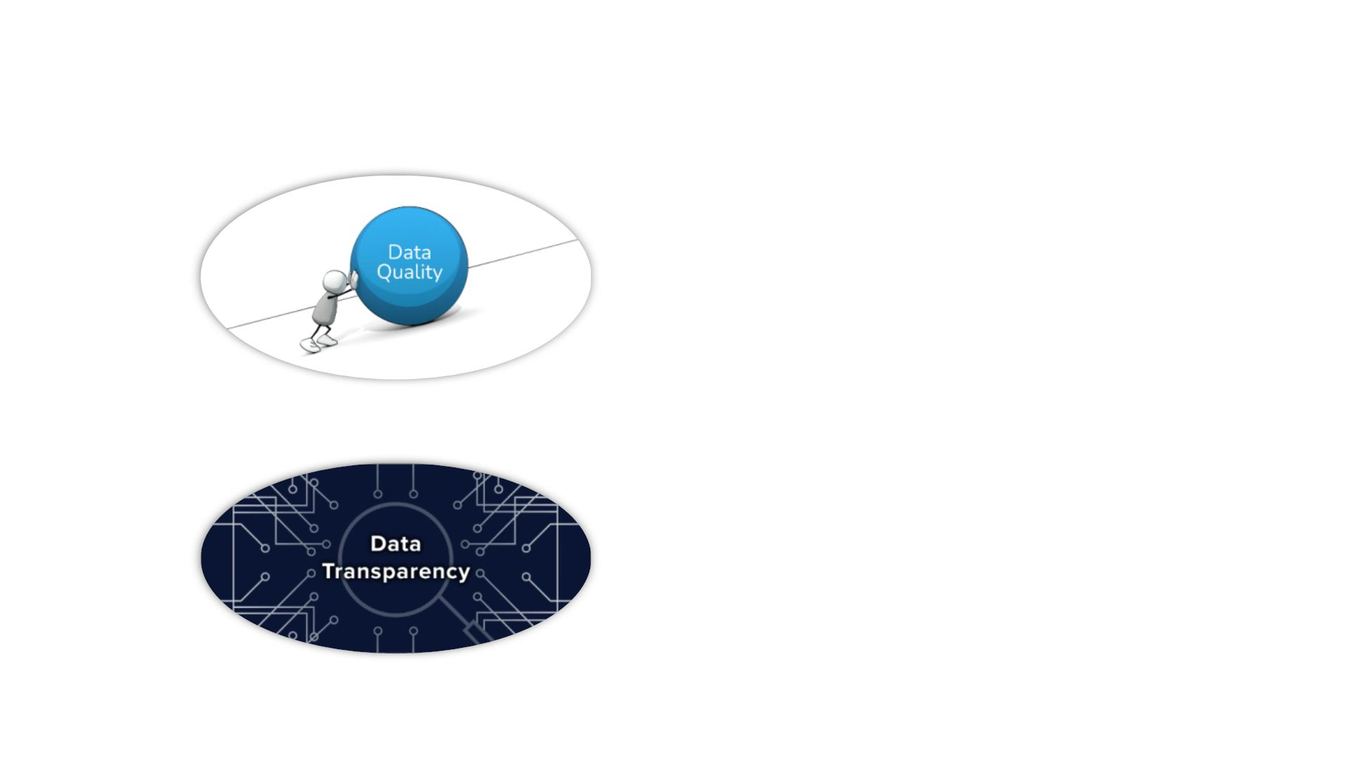
Critical Issues of the BIM Data Management
• Inconsistent BIM object classification
• Insufficient level of information
• BIM data version control
• BIM data change management

Slide 4
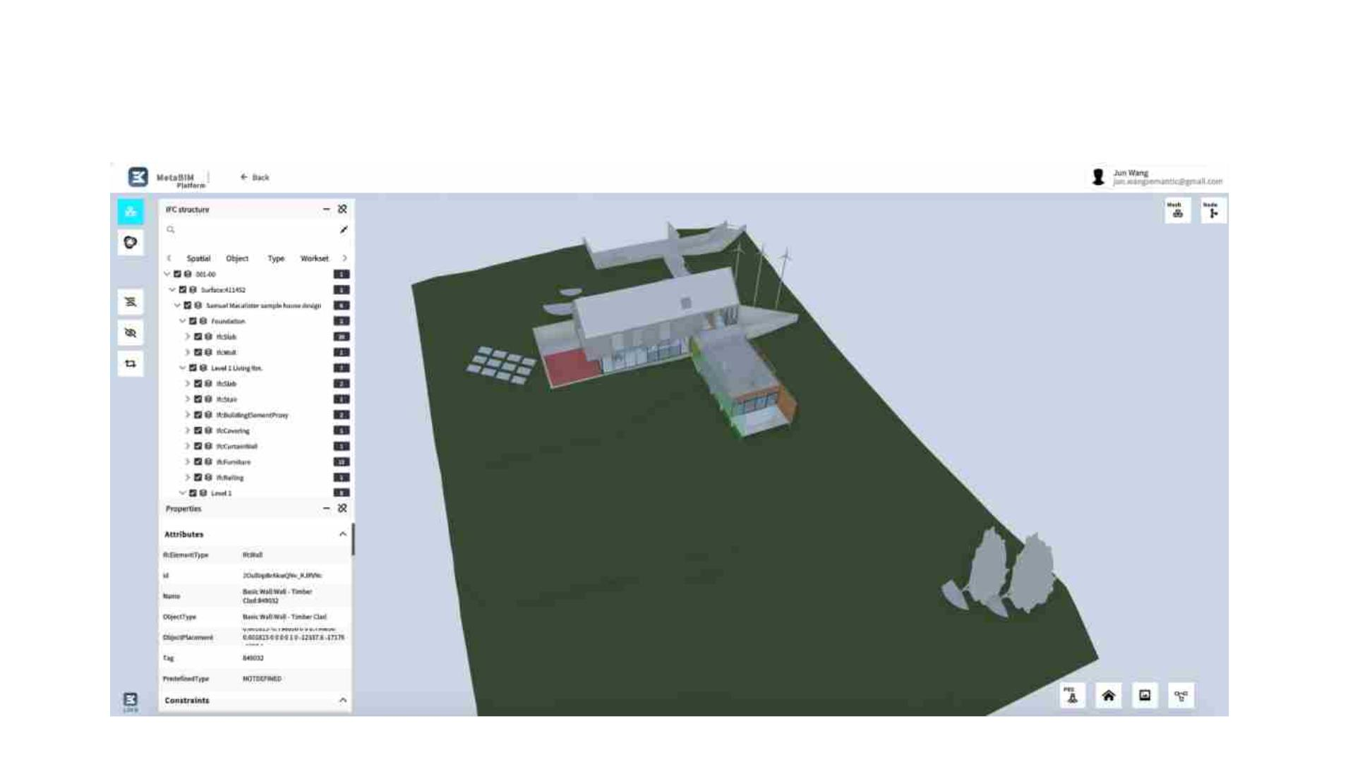
MetaBIM: Web-based OpenBIM platform
A Web-based OpenBIM platform for BIM data parsing, editing, checking, auditing and visualisation

Slide 5

MetaBIM: Key Functions
OpenBIM Standards
Model Comparison
Version Control
Support IFC2X3, IFC4 and IFC4.3
Support BCF create, view, and edit
Support bsDD connection
Compare BIM models in real time;
Git-like version control allows you to
keep track of your BIM data and
helps you to easily explore the
changes you and your team have
made
Visualise differences for both
geometry and non-geometry data
Blockchain Integration
Intelligent BCF
AI & Graph Representation
Provide secure access to a BIM model
and allow for a reliable audit of who
made changes, when they were
BIM object parameters including
placement coordinates and
geometric dimensions can be
automatically captured and used for
driving BIM model auto-updating
Convert BIM data into Graph format,
and apply Graph Neural Network to
automate BIM object classification
made, and what those changes were.

Slide 6
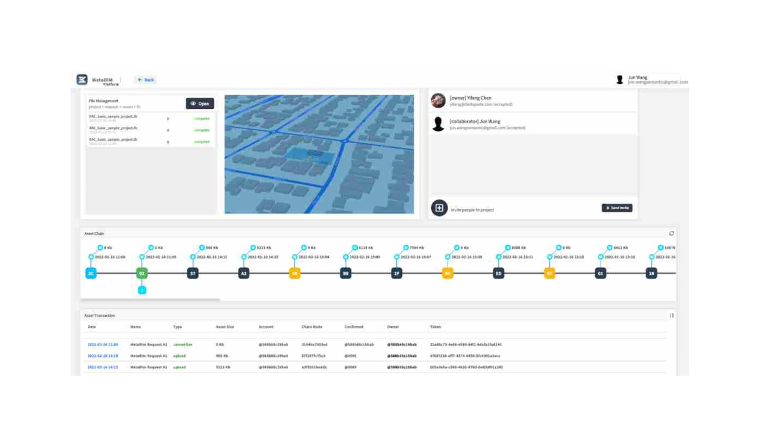
MetaBIM: Blockchain-enabled BIM data auditing

Slide 7
MetaBIM: Key Functions
OpenBIM Standards
Model Comparison
Version Control
Support IFC2X3, IFC4 and IFC4.3
Support BCF create, view, and edit
Support bsDD connection
Compare BIM models in real time;
Git-like version control allows you to
keep track of your BIM data and
helps you to easily explore the
changes you and your team have
made
Visualise differences for both
geometry and non-geometry data
Blockchain Integration
Intelligent BCF
AI & Graph Representation
Provide secure access to a BIM model
and allow for a reliable audit of who
made changes, when they were
BIM object parameters including
placement coordinates and
geometric dimensions can be
automatically captured and used for
driving BIM model auto-updating
Convert BIM data into Graph format,
and apply Graph Neural Network to
automate BIM object classification
made, and what those changes were.

Slide 8

BIM object auto-labelling
Data sources:
• Structured BIM Model Data: AusHFG
• BIM object library
Data collection and labelling:
• Isolate single BIM object and take
images from different angles of views
• Isolate a Room/Space, and take
images from different angles of views

Slide 9
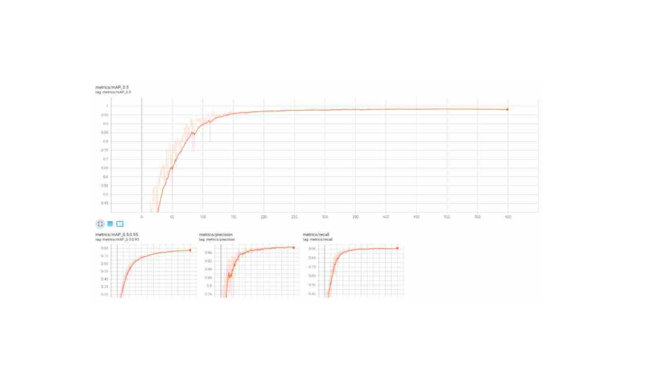
AI algorithm: Training accuracy

Slide 10
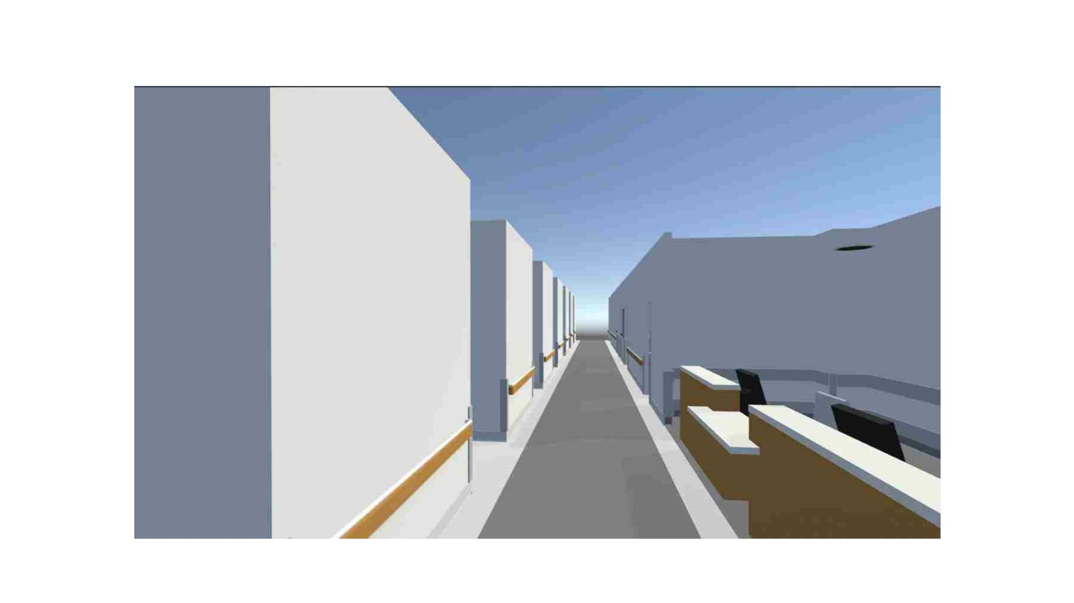
AI algorithm: Validation in a real healthcare building project
Validation Accuracy: Precision VS Recall?

Slide 11
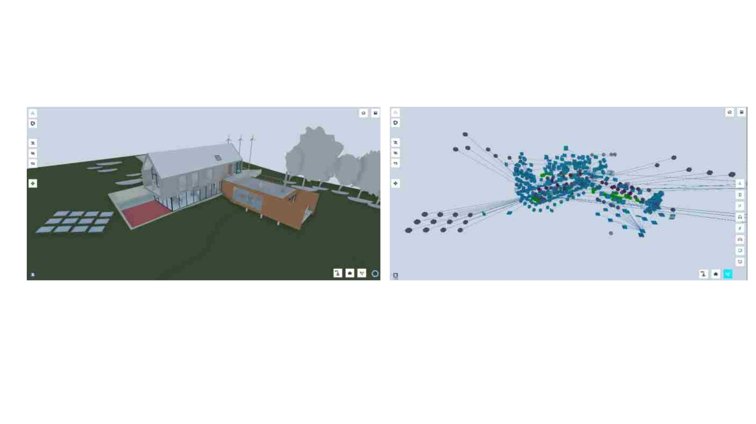
AI algorithm: Integration with Graph Neural Network
3D View
Graph View

