Slide 1
SBEnrc Project 2.82
Digitally-enabled Asset Life-cycle Management
Final Industry Presentation
3 May 2023

Slide 2
ACKNOWLEDGEMENTS
This research has been developed with support provided by Australia’s Sustainable Built Environment National Research Centre (SBEnrc). SBEnrc develops projects informed by industry partner needs, secures national funding, project manages the collaborative research and oversees research into practice initiatives. Core Members of SBEnrc include BGC Australia, Government of Western Australia, Queensland Government, Curtin University, Griffith University, RMIT University and Western Sydney University. This research would not have been possible without the valuable support of our core industry, government and research partners.

Slide 3
Partner contribution
Industry project participants
Main Roads Western Australia
Department of Communities, Housing and Digital Economy, Queensland
Department of Communities, WA
Department of Energy and Public Works, Queensland
Transport for NSW
NATSPEC
WSAA

Slide 4
Partner contribution
PSG Chair:
Steve Golding AM, RFD
Research Team:
Peng Wu (Curtin University, Project Leader)
Ammar Shemery (Curtin University)
Yongze Song (Curtin University)
Jun Wang (Western Sydney University)
Rodney Stewart (Griffith University)
Sherif Mostafa (Griffith University)

Slide 5
DE theme in SBEnrc
2017. P2.51. Developing a Cross Sector Digital Asset Information Model Framework for Asset Management
Determine the effectiveness of existing asset information classification and structuring systems in supporting the practical requirements of asset managers.
2018. P2.64. Unlocking Facility Value through Lifecycle Thinking
- Demonstrates the value of lifecycle thinking and evidence-based decision making in facility asset management.
2020. P2.72. Leveraging an Integrated Information Lifecycle Management Framework – Building and Infrastructure Sectors
- Industry best practices and international standards related to structured and integrated data.

Slide 6
DE theme in SBEnrc
2021. P2.82. Digitally-enabled Asset Life-cycle Management
- A DE-enabled asset life-cycle management process and prototype (MetaBIM) to ensure that DE/BIM models can stay alive after construction and handover.
2023. P2.92. Smarter and greener built assets through digitalisation and AI
- To embed life cycle assessment (LCA) approach into digital twin (digital models with appropriate IoT sensors if required) to assess life cycle emissions of built assets, including housing, building and infrastructure assets.

Slide 7
Content
1. Introducing MetaBIM and key functions
1.1 What is MetaBIM
1.2 Key functions of MetaBIM
1.3 Supporting asset management practices using MetaBIM
1.4 Compliance checking through MetaBIM
1.5 IFC-based 4D construction simulation in MetaBIM
2. Roadside wall detection using AI
3. Amenities and their impact on social housing

Slide 8
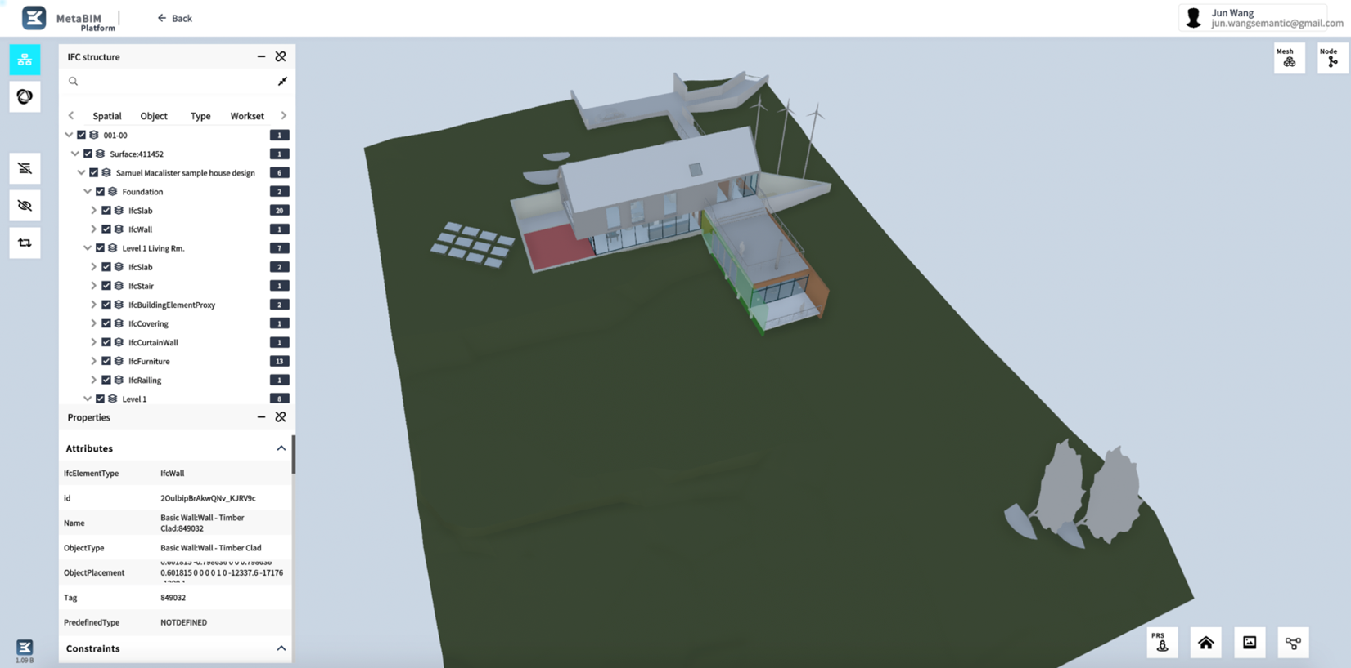
1. MetaBIM
1.1 What is MetaBIM - https://metabim.com.au/
MetaBIM is a Web-based OpenBIM platform for BIM data parsing, editing, checking, auditing and visualisation.

Slide 9
1. MetaBIM
1.2 Key functions of MetaBIM
BIM Model Conditioning
IFC Class mapping and editing
Uniclass mapping and editing
Property adding and editing
Zoning and Splitting
Code Compliance Checking
Rules creation and management
Rule-based code checking
BCF report generation
Cost Estimation (Coming soon)
Quantity take-off
Bill of Materials Preparation
Link to external cost database
Cost estimation and analysis
Life Cycle Assessment (Coming soon)
Carbon footprint calculation & visualisation
Carbon pricing
Carbon offsetting

Slide 10
1. MetaBIM
1.2 Key functions of MetaBIM – BIM Parser
BIM Model
BIM Parser
Object 1
Object 2
Object 3
Object …
Great efficiency in:
Storage
Query
Comparison
Auditing
Version 1
Obj_Version_ 1
Obj_Version_ 1
Obj_Version_ 1
Obj_Version_ 1
BIM
Model-level version control
Version 2
Obj_Version_ 2
Obj_Version_ 1
Obj_Version_ 1
Obj_Version_ 1
Version 3
Obj_Version_ 2
Obj_Version_ 1
Obj_Version_ 2
Obj_Version_ 1
Version …
BIM Object-level version control
Selected Version
BIM Model
Export

Slide 11
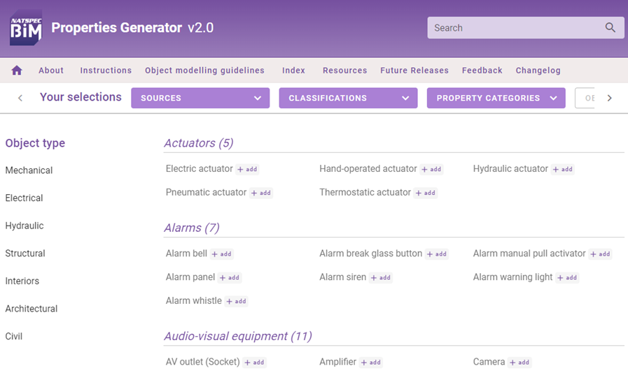
1. MetaBIM
1.3 Supporting asset management practices using MetaBIM
Task 1 - Validation of as-constructed data during handover stages
Task 2 - Integration of asset data from various data sources
Task 3 - Classification of as-built BIM model objects according to the AUS-SPEC activity specification and NATSPEC Maintenance reference worksections
List of AUS-SPEC Activity specifications and related NATSPEC reference worksections

Slide 12
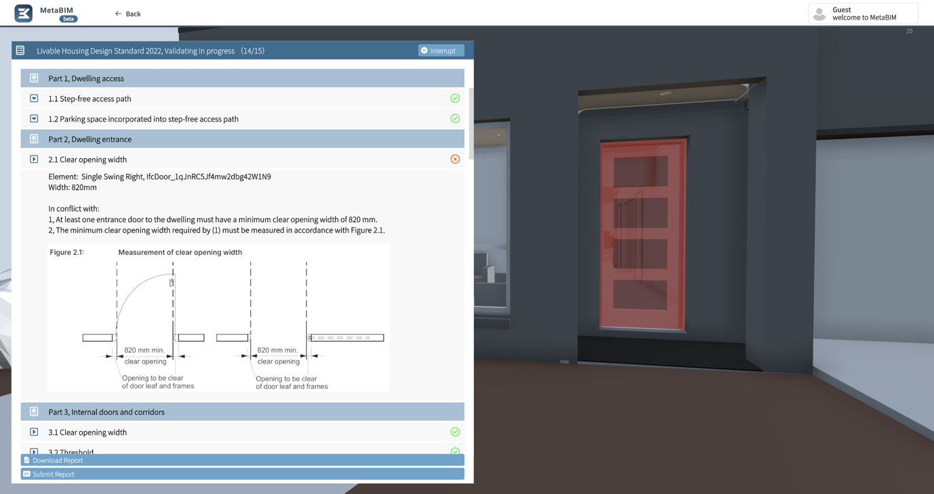
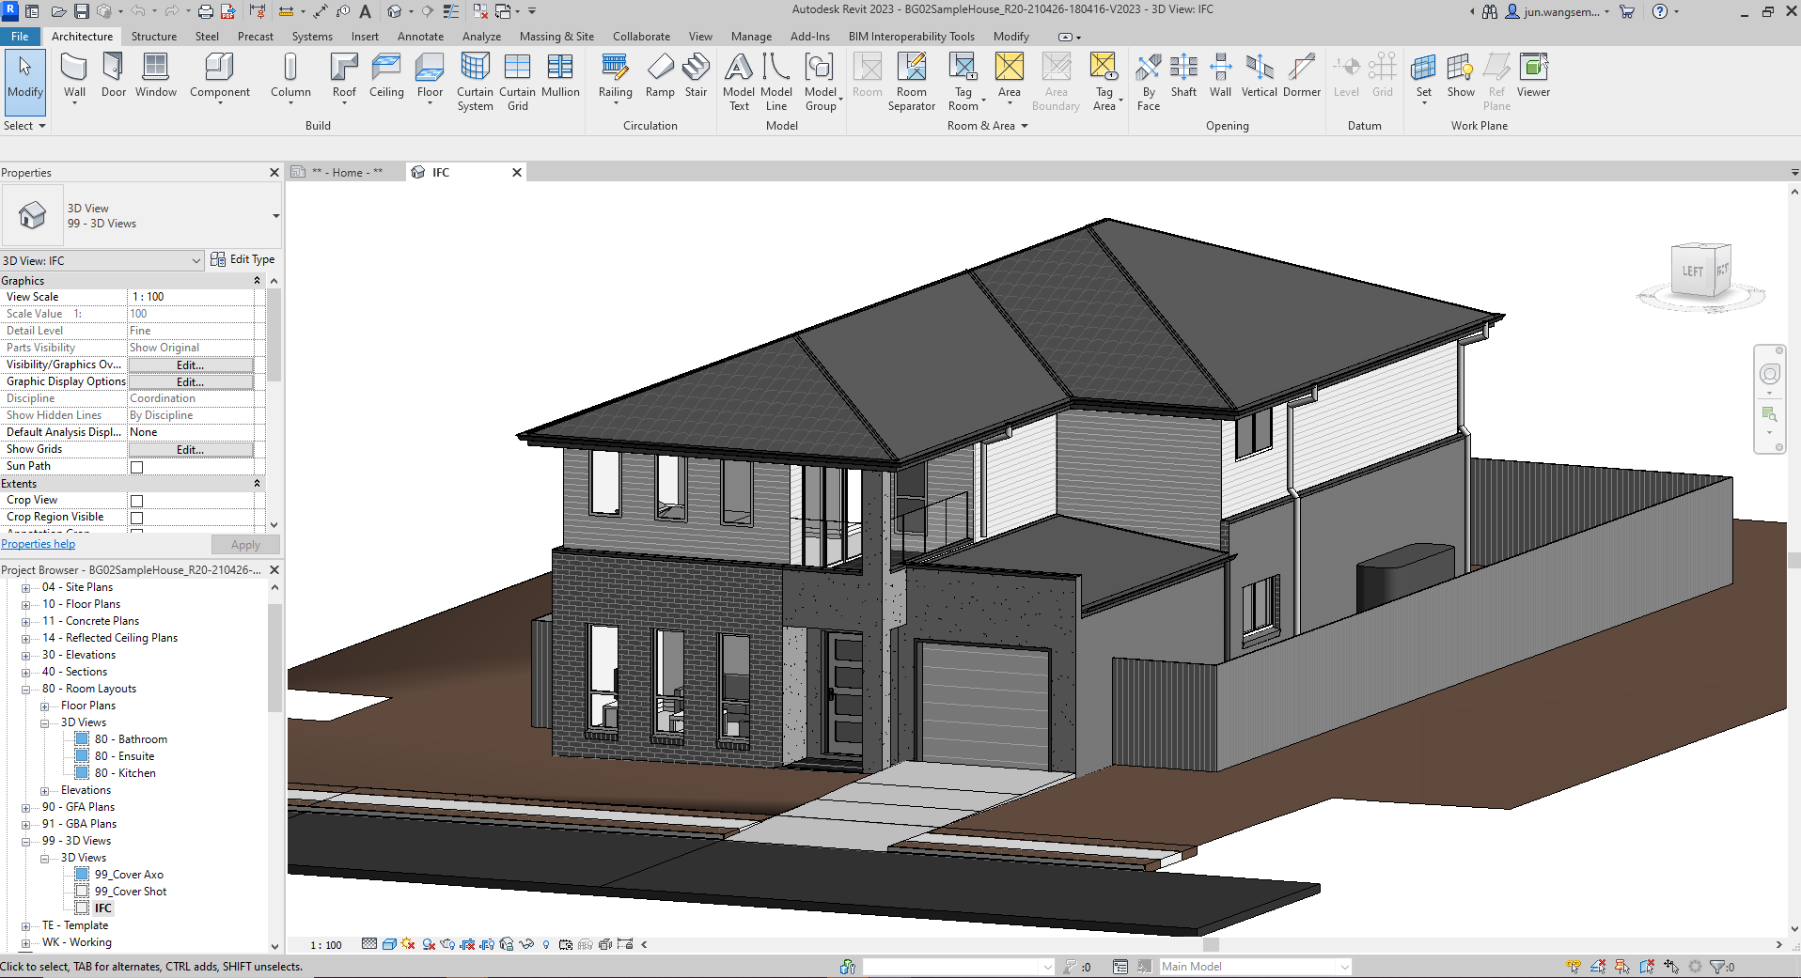
1. MetaBIM
1.4 Compliance checking using MetaBIM – Livable House Design Check
Revit House Model from BIM Guru
BIM-based Livable House Design Check (the dwelling entrance check has failed as the width of the door leaf for the entrance door in the given BIM model is 820mm, which is less than the required 870mm for a clear opening width of 820mm for a single swinging door.)

Slide 13
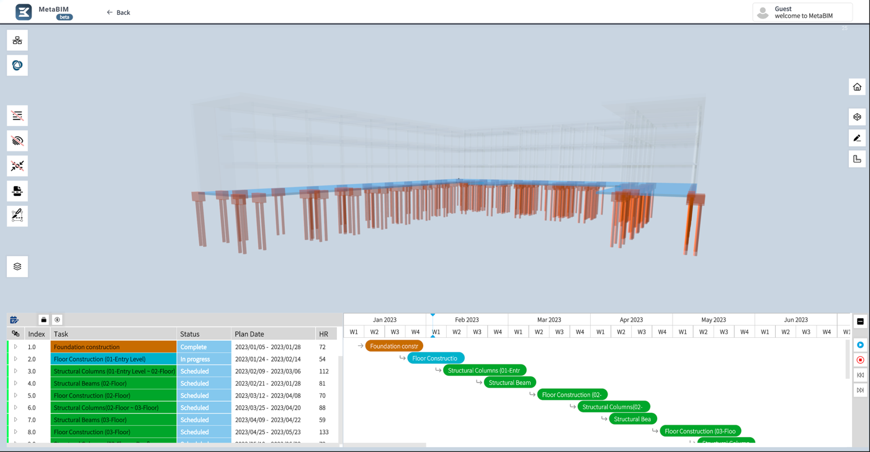
1. MetaBIM
1.5 IFC-based 4D construction simulation in MetaBIM
The use of IFC for creating and saving 4D construction simulation provides two key benefits:
Longevity refers to the ability of the 4D simulation to be used and accessed over a long period of time, even if the software or company that created it is no longer in business.
Interoperability refers to the ability of different software programs and systems to work together seamlessly.

Slide 14
1. MetaBIM
Some useful information about MetaBIM can be found from the below links:
Link to MetaBIM Platform: https://platformdev.metabim.com.au/
A short video demonstration of the platform: https://metabim.com.au/platform.html
MetaBIM webste: https://metabim.com.au/

Slide 15
2. Roadside wall detection using AI
Roadside walls are common highway structures. These offer functions such as noise reduction. To ensure quality, these wall structures should satisfy general physical and specific acoustic requirements.
This case study aimed to develop a tool for extracting features and recognizing objects in roadside wall structures.

Slide 16
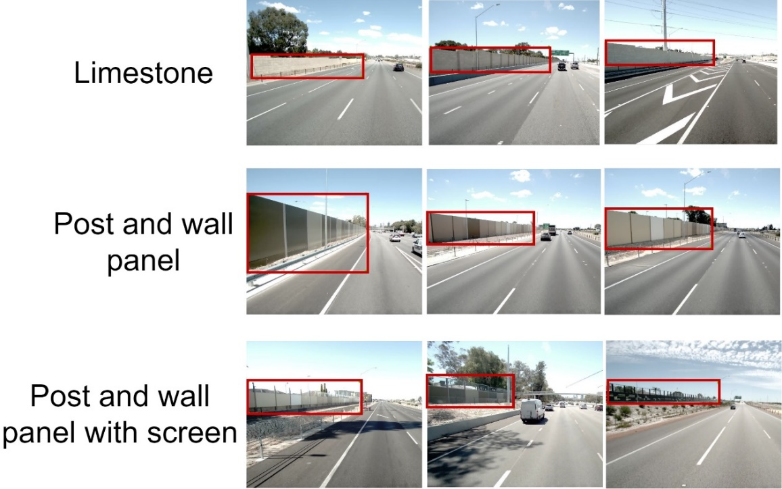
2. Roadside wall detection using AI
This project selects the “You Only Look Once Version 5” (YOLO-v5) as the basic object detection algorithm. It is further modified based on training.
The raw inputs for the case study were 12 videos from the high-speed data provided by MRWA.
In total, 1,059 images were selected from the 12 videos. In this study, the training test/validation ratio was set as 9:1. Thus, 953 images were randomly selected as training datasets, and the remaining 106 images were used for validation.

Slide 17
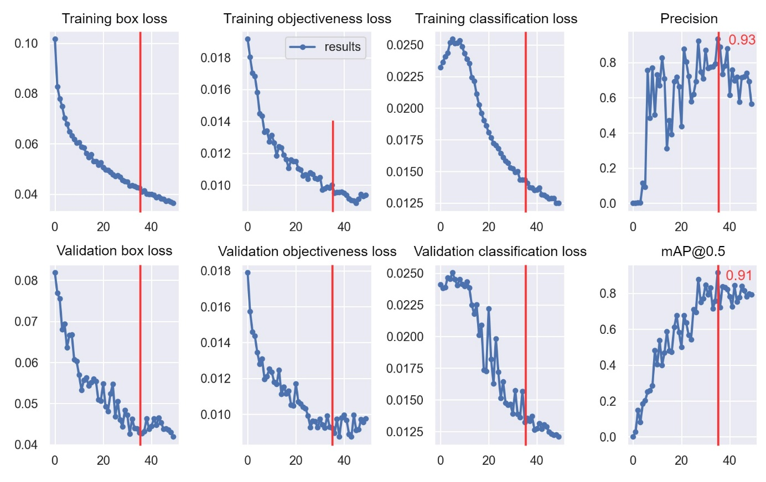
2. Roadside wall detection using AI
A pilot test comprising 50 training sessions was conducted. In terms of accuracy, the best-trained parameters occurred at the 35th training iteration. This optimal set of parameters had a precision of 93% and mean averaged precision (mAP) of 91%.

Slide 18
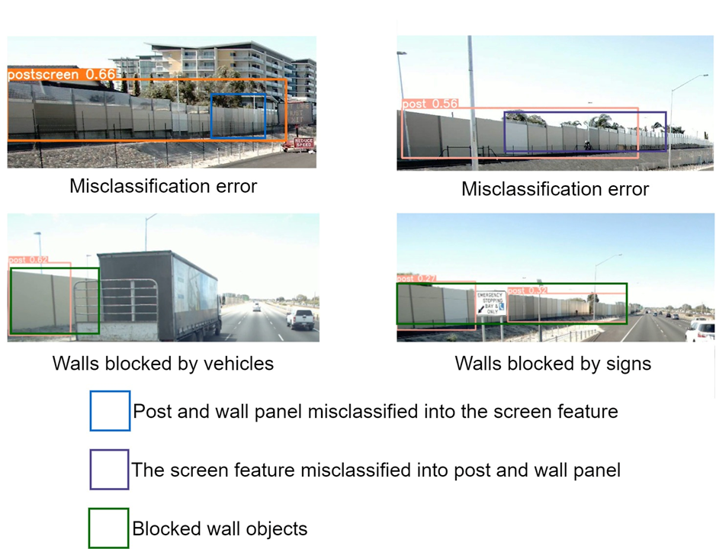
2. Roadside wall detection using AI
The general performance of this pilot machine learning model is acceptable; however, its accuracy is limited owing to misclassification and issues such as missing objects blocked by other features.
Nevertheless, AI can be used for roadside wall detection with satisfactory performance and extending its use to detect roadside walls for the entire network is feasible.

Slide 19
3. Amenities and their impact on social housing
Background
Significance of location and accessibility in social housing, as they influence tenant satisfaction & community participation
Internal and external amenities, socio-economic factors, and individual perceptions influence residential satisfaction
Better tools for measuring amenity satisfaction in the social housing context.
Objectives
Review literature on public and housing amenities
Explore the correlation between amenities and tenant satisfaction

Slide 20
3. Amenities and their impact on social housing
Types of amenities
Location of residence
House design
House features, e.g. car parking, energy efficiency, yard space and fencing, water efficiency
Size of the living spaces, e.g. no of bedrooms, size of cooking and storage spaces
Safety and Privacy
Food stores & groceries
Pollution
Proximity to public transportation
Access to medical services
Recreational facilities
Education centres
Other facilities access, e.g. community centres, worship places, shops and banking
Neighbourhood/ Community amenities
Household/Dwelling/Properties amenities

Slide 21
3. Amenities and their impact on social housing
Understanding Satisfaction in Residential Environments
Satisfaction is the resolution of a want, influenced by changing desires and social contexts
Factors contributing to satisfaction:
Housing amenities
Neighbours and neighbourhood facilities
Residential satisfaction as an indicator of the quality of life and behavioural patterns
Research focuses on cross-sectional data, including:
Socioeconomic traits
Housing and neighbourhood characteristics
Environmental amenities
Alignment between resident preferences and real-world circumstances

Slide 22
3. Amenities and their impact on social housing
Measuring Neighbourhood and Household Amenities Satisfaction
Neighbourhood satisfaction
Perception of comfort or discomfort within a neighbourhood
Influenced by amenities, safety, accessibility, and environment
Correlated with life satisfaction, happiness, and eudaimonia
Geospatial analysis in GIS is used to measure satisfaction based on the distance to amenities
Household amenities satisfaction
Assessment of end-user satisfaction for housing units considering building characteristics, neighbourhood, socio-cultural amenities, and management
Factors linked to housing satisfaction include structure quality, design, size, internal space, amenities, and cost

Slide 23
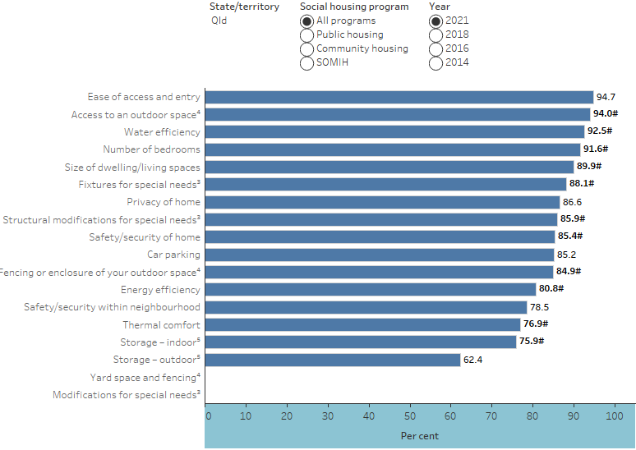
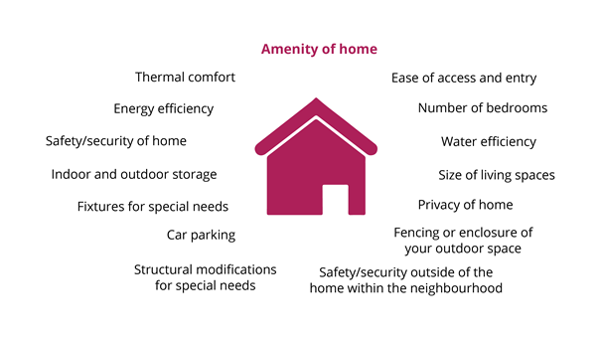
3. Amenities and their impact on social housing
National Social Housing Survey in Australia
AIHW: National Social Housing Survey 2021

Slide 24
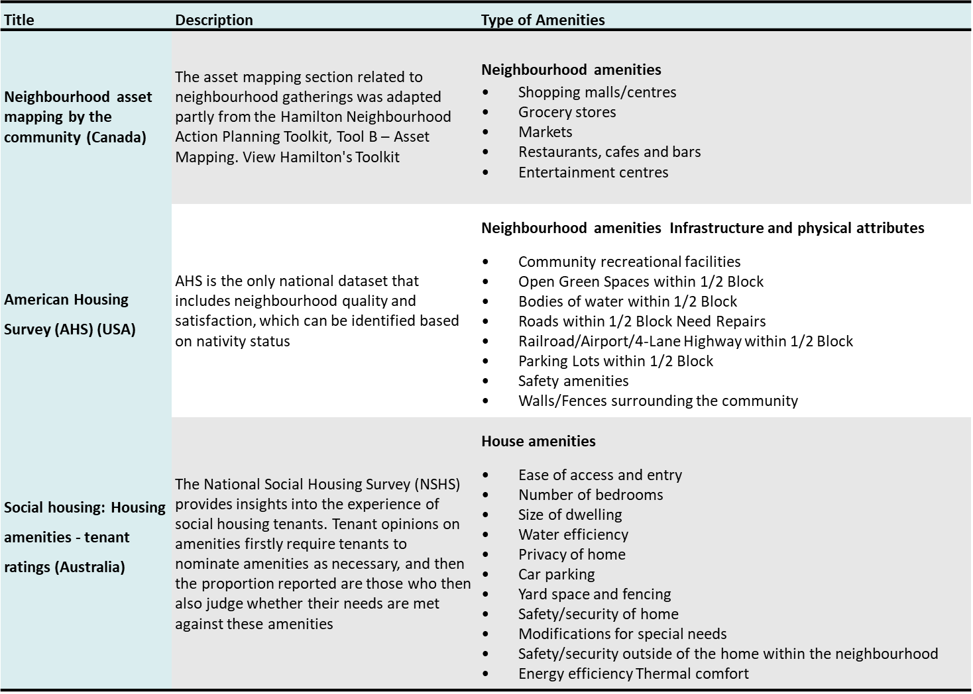
3. Amenities and their impact on social housing
Existing approaches to measuring amenities satisfaction

Slide 25
3. Amenities and their impact on social housing
Concluding Remarks and Recommendations
Subjective perception drives residential satisfaction
Socio-cultural influences on desired neighbourhood amenities
Flexible measurement criteria and accounting for multiple factors
Focus on neighbourhood amenities and socio-cultural amenities
Use a multi-dimensional approach for measuring housing satisfaction
Data-driven Techniques for geospatial amenity accessibility analysis

Slide 26
Moving forward
2023-2024. P2.92 Smarter and greener built assets through digitalisation and AI
This project aims to systematically investigate how digital twin (DT) and relevant technologies, e.g., IoT and artificial intelligence, can be adopted to manage built assets towards efficiency and sustainability.
The expected outcomes include a digital twin platform that assists life cycle emissions analysis and reporting, as well as embedded AI-driven approaches to achieve operational efficiency and lower emissions of built assets.
We welcome potential partners who intend to explore the benefits of advanced digital engineering and artificial intelligence approaches in their daily practices.
More information can be found at:
https://sbenrc.com.au/research-programs/2-82/
https://sbenrc.com.au/research-programs/2-92/

