Slide 1
Landfill Levy Imposition on Construction and Demolition (C&D) Waste: Australian Stakeholders’ Perceptions
Presented by : Salman Shooshtarian
School of Property, Construction and Project Management, RMIT University

Slide 2
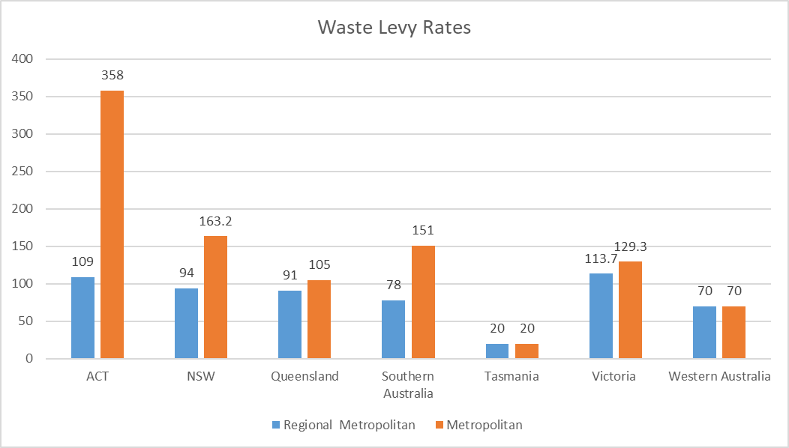
Introduction to Landfill Levies in Australia
In Australia, the landfill levy rate is determined by state and territory governments
The first Australian levy scheme was enforced in NSW metropolitan area in 1971 which was rated at $0.51 per tonne
Except for Northern Territory, all other jurisdictions have introduced landfill levies
Disparity in landfill levy rate exists due to the location of waste disposal (metropolitan vs regional), obligatory versus voluntary, having a tax exemption for certain materials and levy zones

Slide 3
Project 1.65: National Economic Approach to Improved Management of Construction and Demolition Waste
The project aimed to achieve the following objectives:
Review regulations and their application in practice in different jurisdictions governing C&D waste management, identifying discrepancies and making recommendations for reforms.
Develop a consistent approach to define and measure C&D waste across different jurisdictions.
Identify economic factors that govern the disposal and reduce/reuse/ recycling of C&D waste.
Conduct a feasibility study on creating a marketplace to connect organisations and industries across jurisdictions for trading waste
Identify opportunities to integrate supply chains and develop an integrated supply chain lifecycle model espousing a cradle-to-cradle approach.

Slide 4
Who were involved?

Slide 5
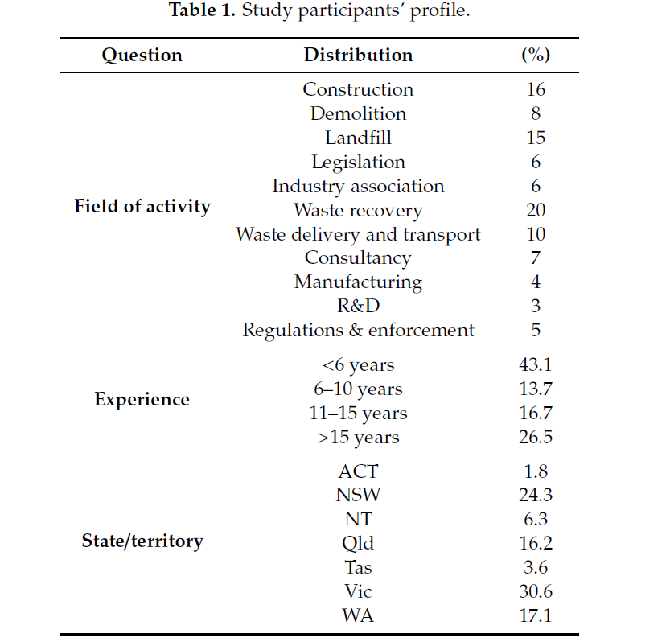
Methodology
A questionnaire survey was administrated in 2020
The final version of the questionnaire contained 46 questions
132 participants responded to the questionnaire
This presentation only focuses on questions related to landfill levy

Slide 6
Findings

Slide 7
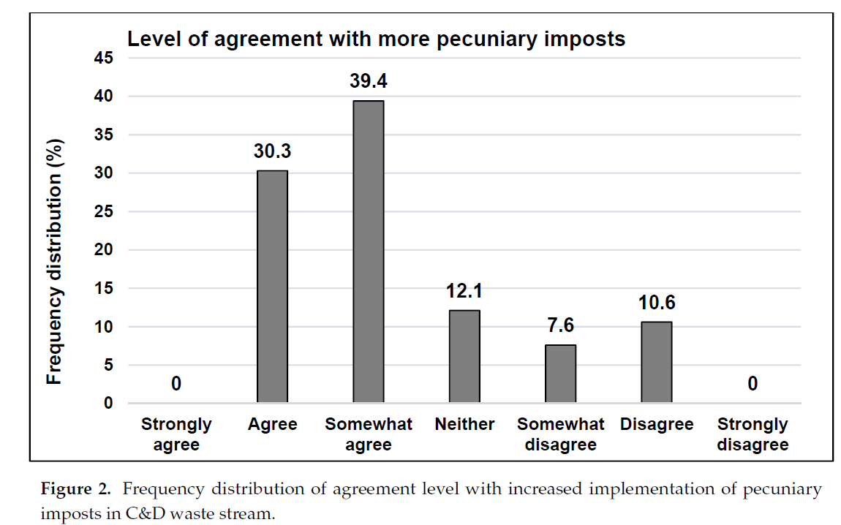
Case Studies Selection Criteria

Slide 8
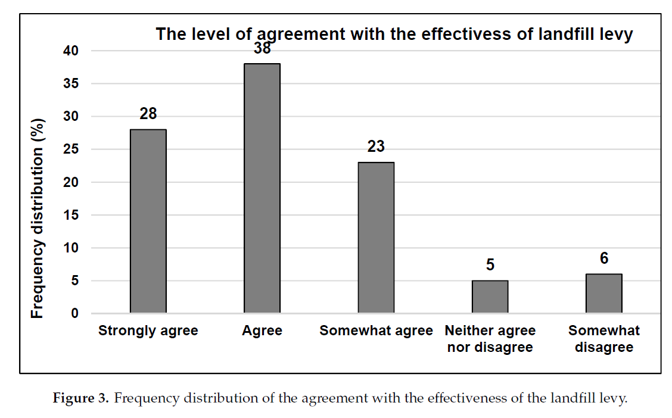

Slide 9
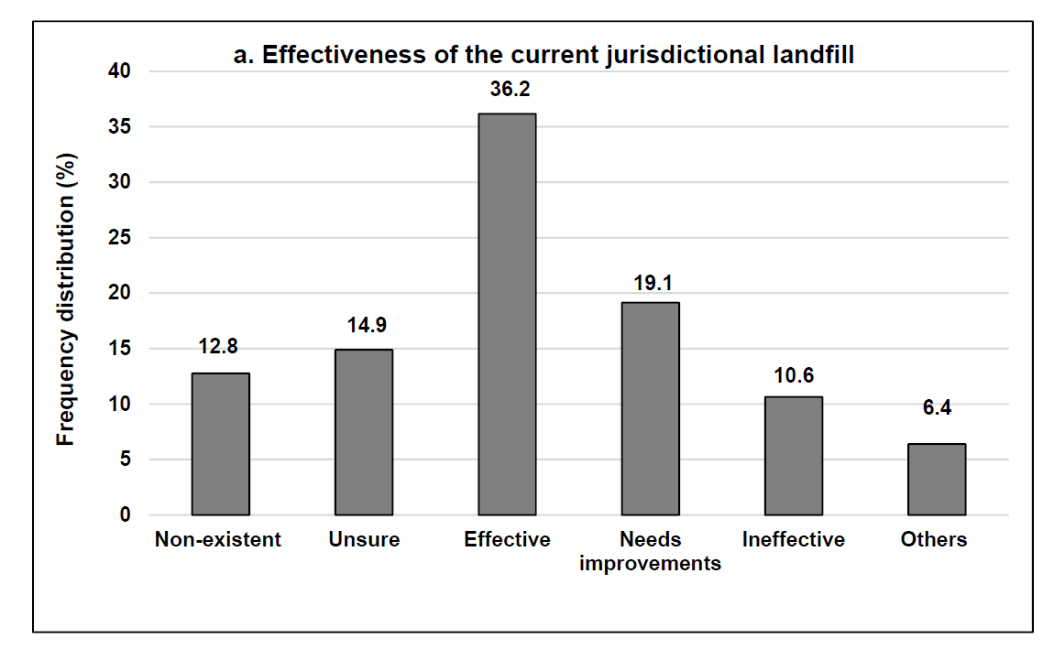

Slide 10
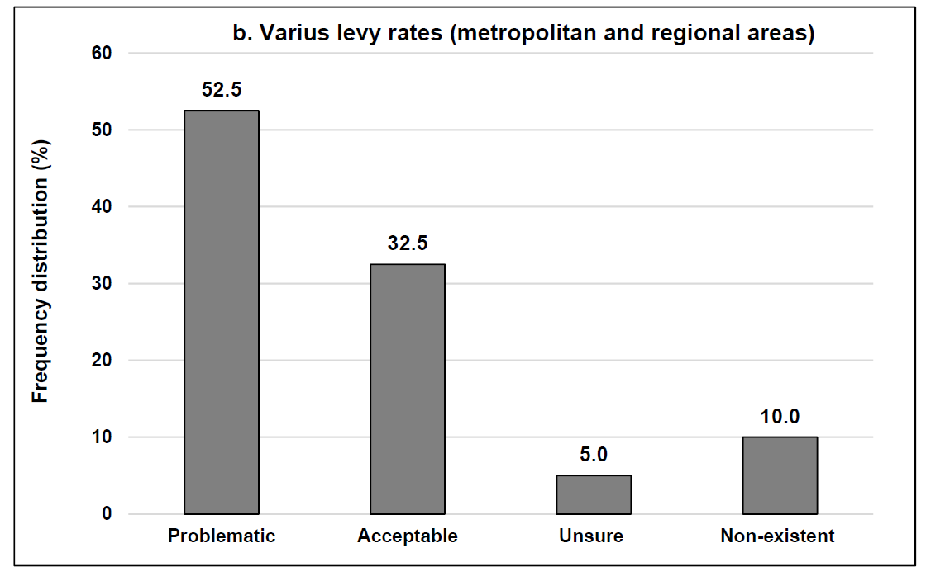
Various levy rates (metro vs regional)

Slide 11
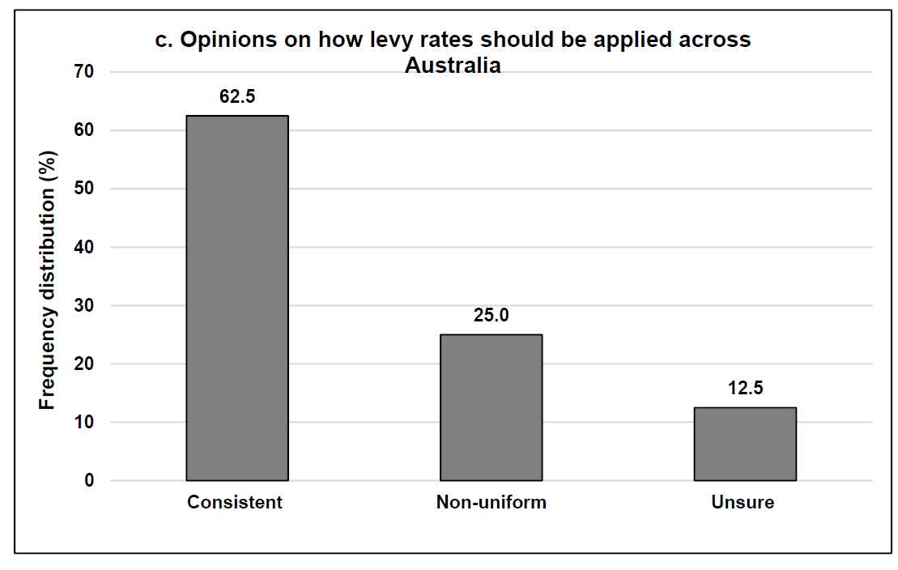

Slide 12
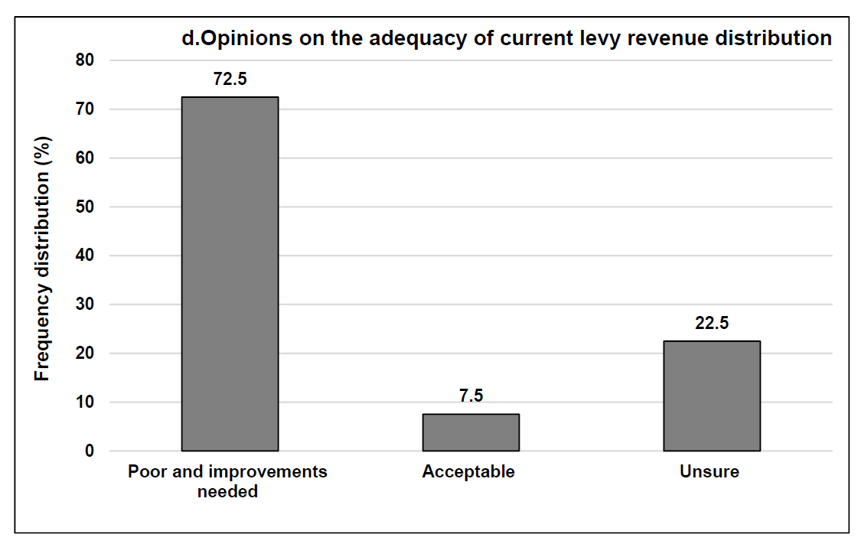

Slide 13
Improvement areas:
National harmonisation of landfill levies
Any increase in levy rate should be complemented with effective compliance and enforcement regime
The levy revenue should be allocated to the activities that directly improve the waste recovery industry.
An increase in the number of local infrastructures discourages waste producers from sending waste to landfill
Government funding to improve waste recovery facilities together with effective law enforcement provides an impetus for further waste recovery
Development of the domestic market for recycled materials is an effective approach in this space.

Slide 14
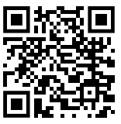
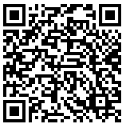
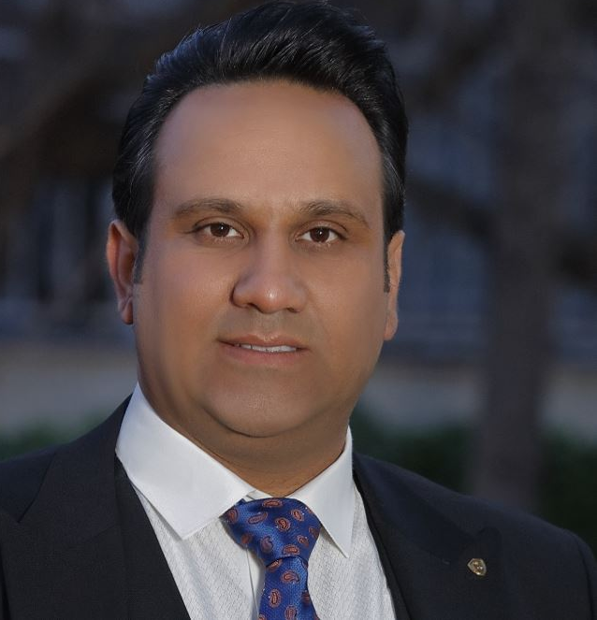
Contact details
Journal article
Project Webpage:
https://sbenrc.com.au/research-programs/1-65/
To get a free copy of the project final industry report please contact me at:
Industry report
Dr Salman Shooshtarian
RMIT University, Melbourne, Australia
E: salman.shooshtarian@rmit.edu.au

Slide 15
Thank You for Your Attention

