Slide 1
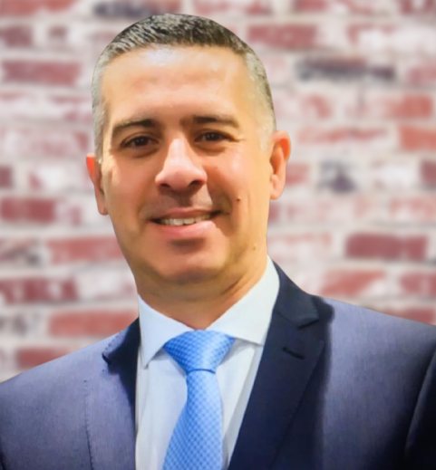
Social and Affordable Housing A decade of Industry-led Research
Subtitle
Ammar Shemery
Chief Operating Officer
Sustainable Built Environment National Research Centre, Australia (SBEnrc)

Slide 2
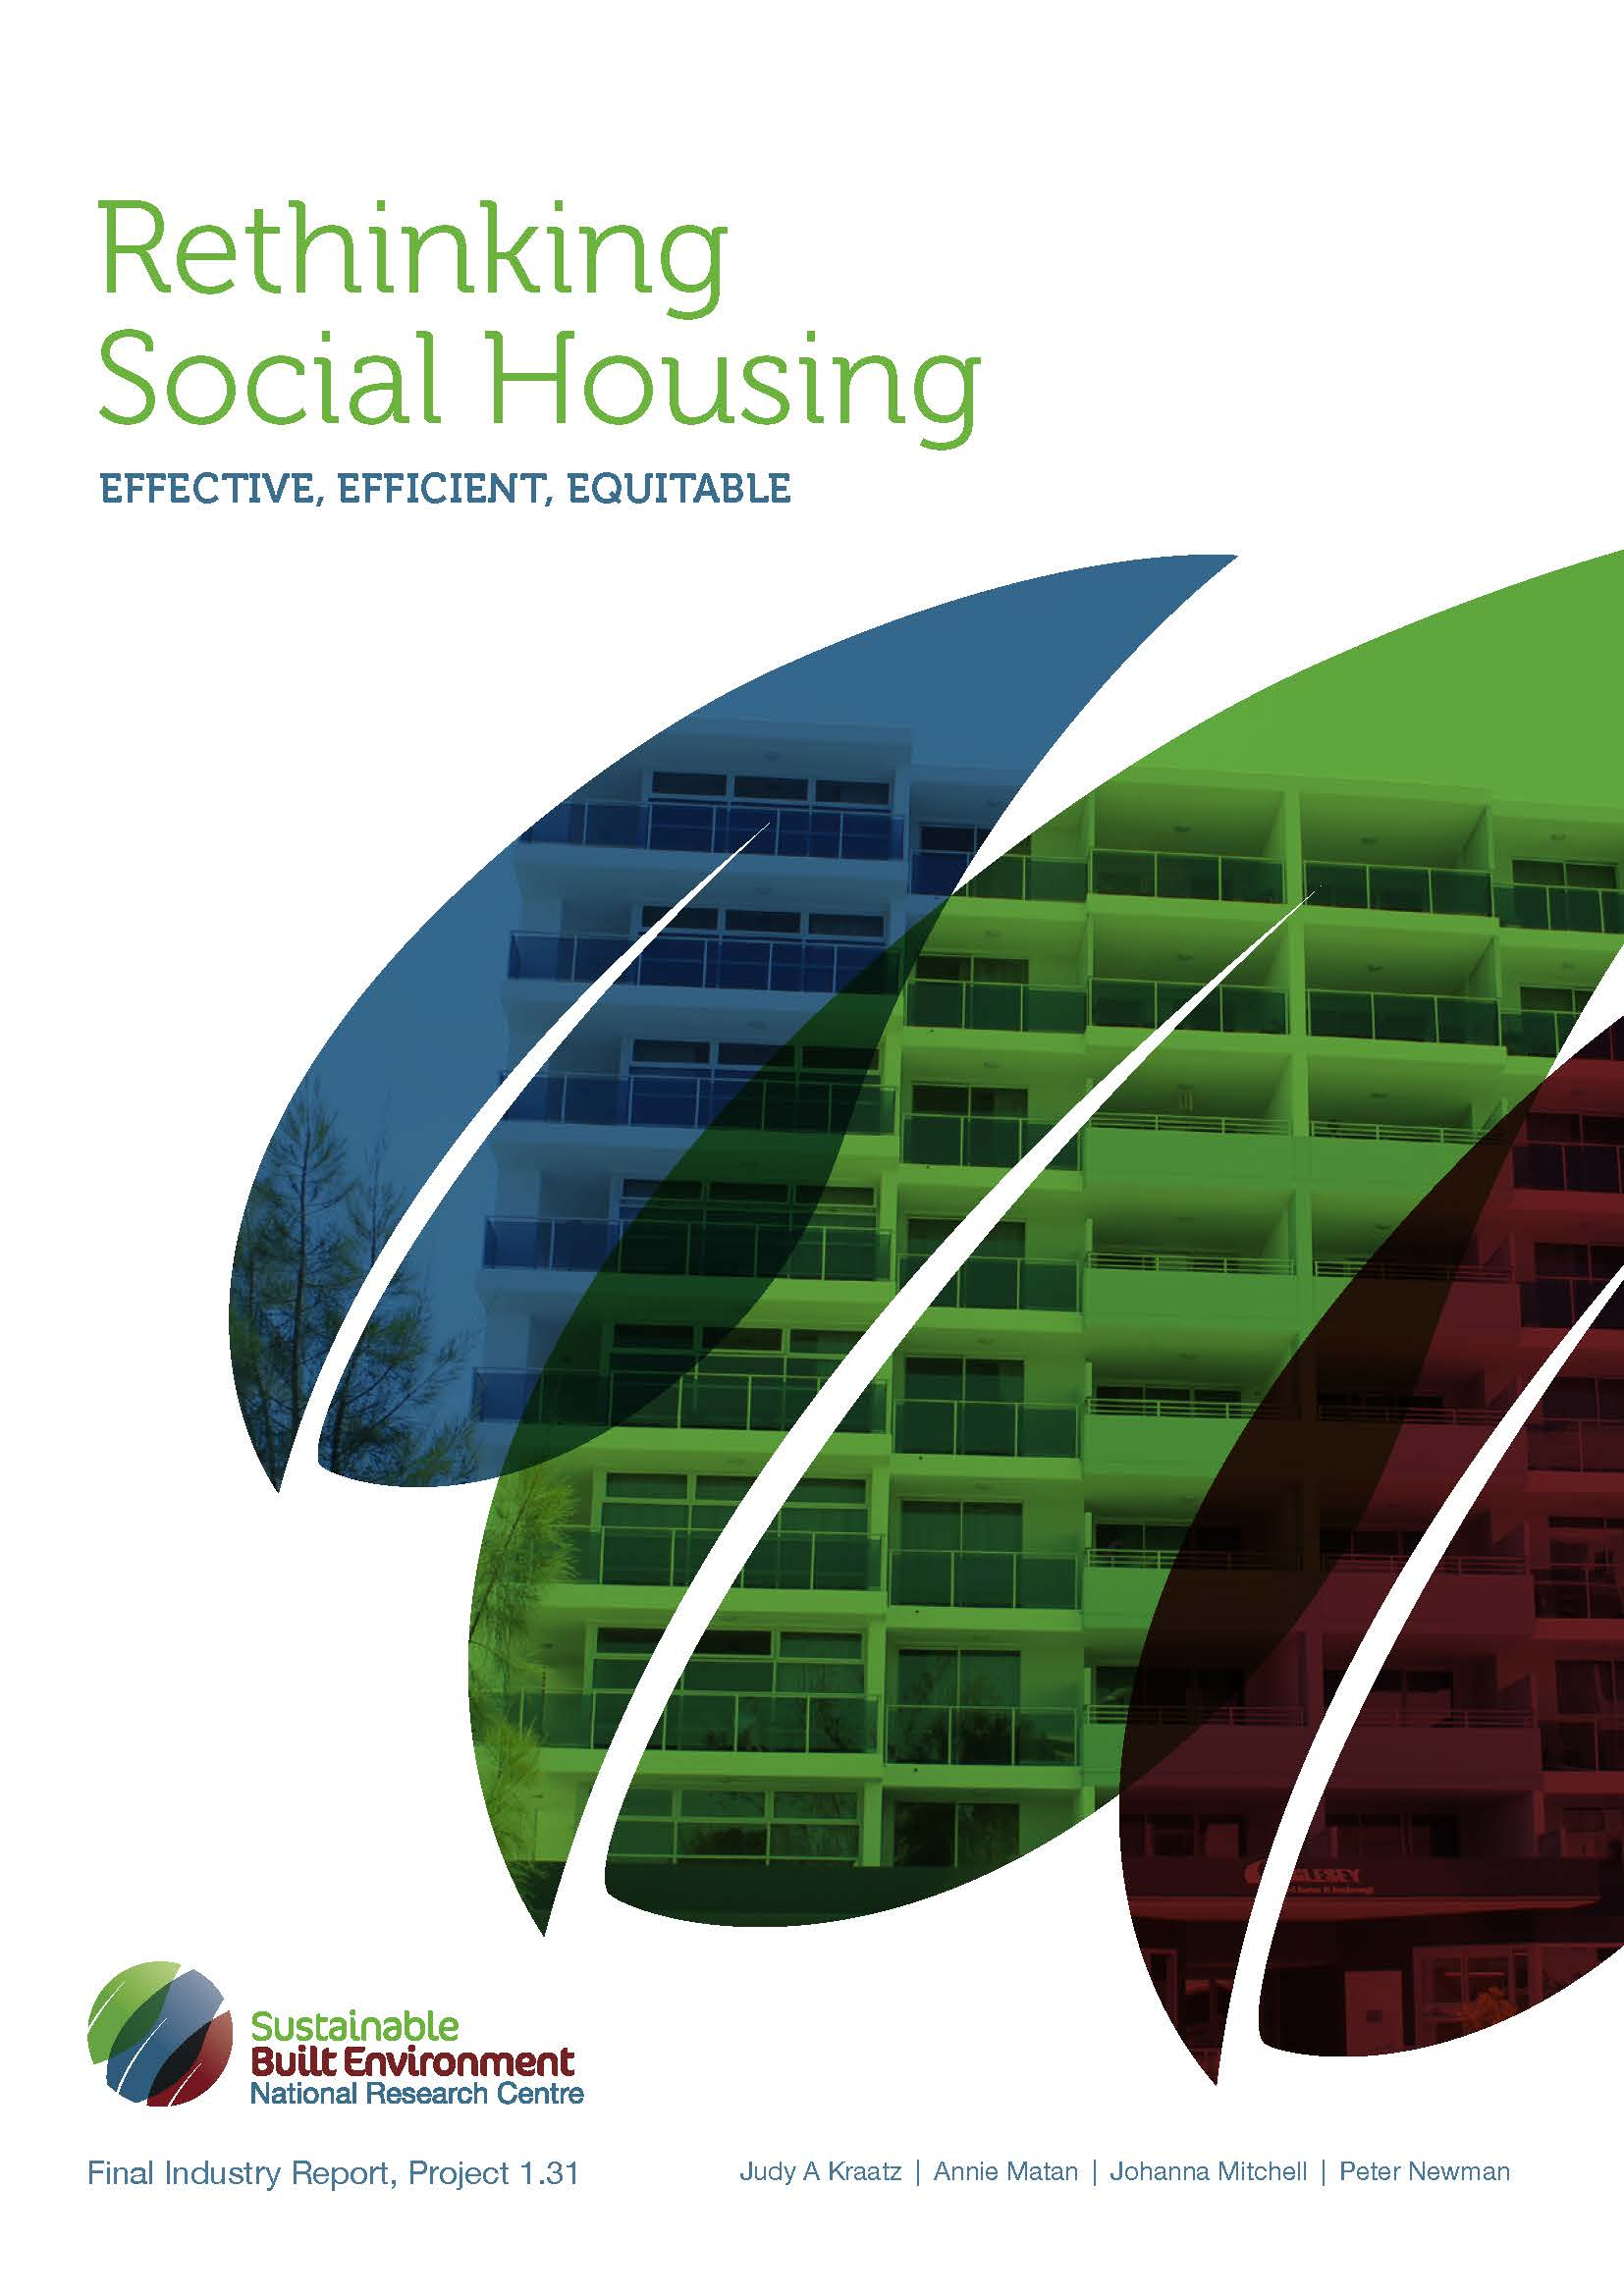
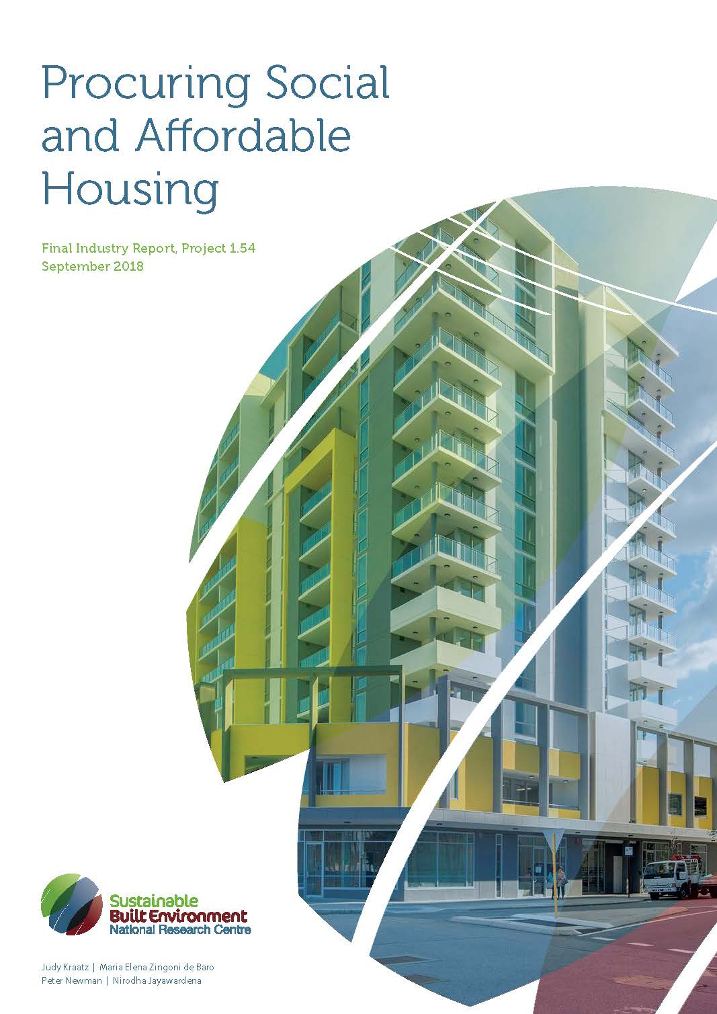
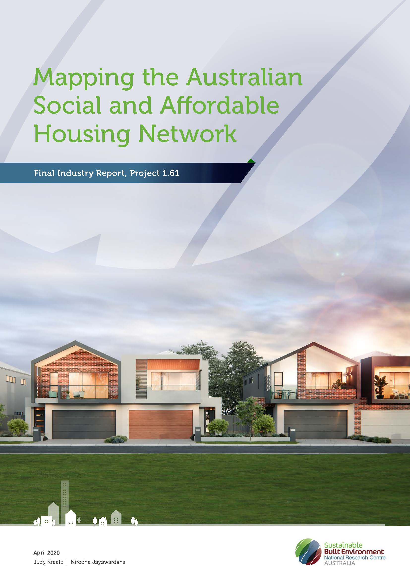
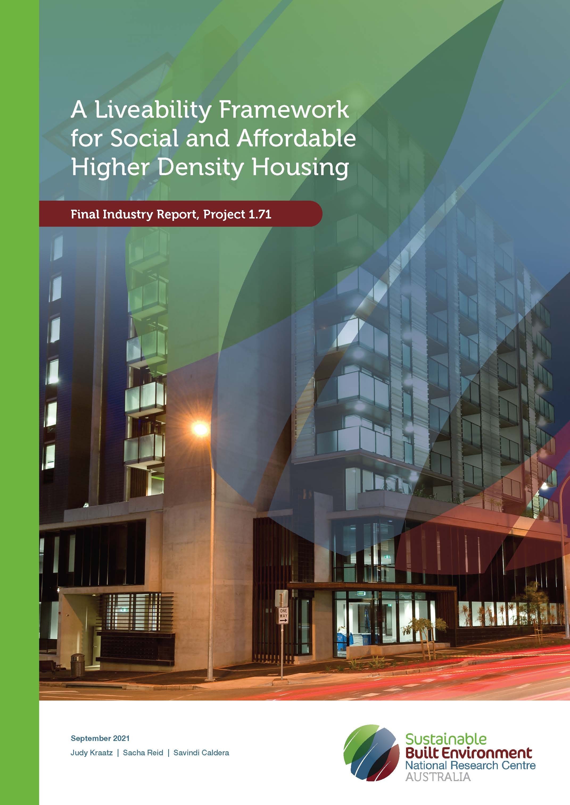
SBEnrc Social and Affordable Housing Program
2014 – 2015
2015 – 2016
2016 – 2017
2018 - 2019
2019 - 2021
2021 - 2023

Slide 3
Build-to-Rent (BtR)
2023 – 2024
Improved alignment between government and market mechanisms.
Inform and address need for increased and more diverse supply of housing.
Inform delivery of safe, effective and desirable housing to address supply issue into the future.
BtR Framework and recommendations to upskill broader industry.
Impact on social and affordable housing capacity to provide desirable housing for people at all ages and stage of life.

Slide 4
SBEnrc Core Partners

